Slide 1
Real Distribution System Modeling and Analysis using OpenDSS
GRA: Fankun Bu
Advisor: Dr. Zhaoyu Wang
Department of Electrical and Computer Engineering
Iowa State University

Slide 2
Utility I
These slides have been edited to remove business-sensitive information.

Slide 3
Outline
A Real Distribution System
  System Information
  Raw AMI Data
Steps of Developing the OpenDSS Model
  Process the Raw Data
  Develop the OpenDSS Model
    Power Flow Analysis
    Matlab-OpenDSS Interface
    Numerical Results
ECpE Department

Slide 4
A Real Distribution System
Overview of System Information and Raw Data
This is a real distribution grid located at Midwest U.S, and it belongs to a municipal utility and it is a fully observable network with smart meters installed at all customers.
System Information
AMI Data
2 substations
4 load tap changing substation transformers (69/13.8 kV)
14 feeders (83 miles)
1489 overhead line sections
2582 underground cable sections
5 capacitor banks
361 switching devices
>1000 distribution transformers
5212 customers
Time period: >4 year (2015-2018)
4321 residential customers
696 small commercial customers
146 large commercial customers
17 industrial customers
32 other customers
Time resolution:
  Hourly – residential, small commercial
  15-min – large commercial, industrial
ECpE Department

Slide 5
A Real Distribution System
Overview of System Information and Raw Data
https://www.milsoft.com/utility-solutions/upgrades/engineering-analysis-windmil
System Model 1-- Map
System Model 2 -- Milsoft model
Geographic information
Overhead line
Underground cable
Circuit breaker
Switch
Fuse
Capacitor bank
Distribution transformer
Geographic information
Equivalent voltage source
Substation transformer
Tap changer
Circuit breaker
Switch
Fuse
Capacitor bank
Overhead line
Underground cable
ECpE Department

Slide 6
A Real Distribution System
Overview of System Information and Raw Data
Hourly energy & instantaneous voltage
Time
one
Acct.
…
…
Raw AMI data
ECpE Department

Slide 7
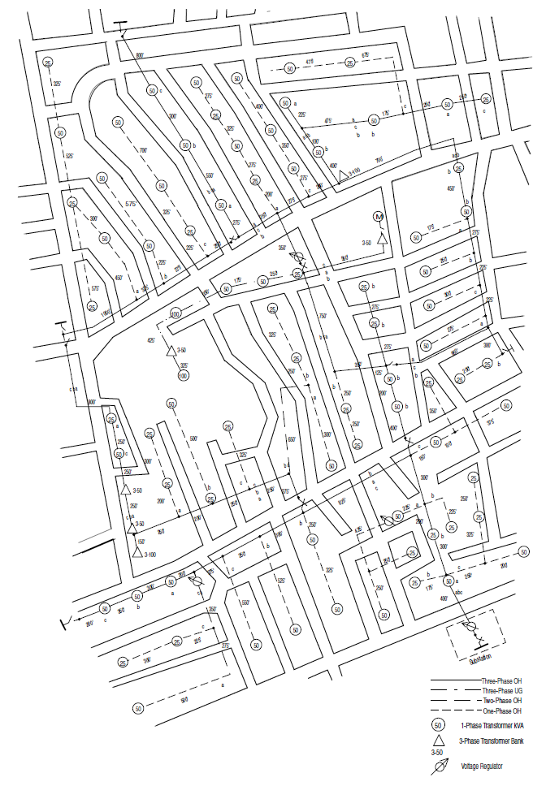
A Real Distribution System
System Information
What is distribution system map?
A distribution system map contains all the electric devices in a distribution grid, as well as geographic information. The map makes a foundation for utility’s normal operation and future planning.
This map contains most of the following information:
1. Lines
a. Location
b. Distances
c. Conductor sizes
d. Phasing
2. Distribution transformers
a. Location
b. kVA rating
c. Phase connection
3. In-line transformers
a. Location
b. kVA rating
c. Connection
4. Shunt capacitors
a. Location
b. kvar rating
c. Phase connection
5. Voltage regulators
a. Location
b. Phase connection
c. Type
i. Single-phase
ii. Three-phase
6. Switches
a. Location
b. Normal open/close status
Distribution system map of the IEEE-123 Node test feeder
ECpE Department

Slide 8
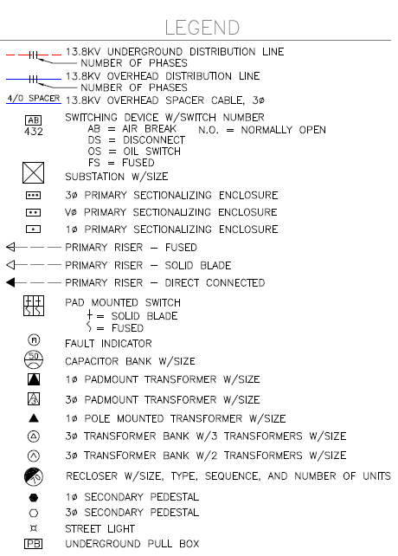
A Real Distribution System
System Information
ECpE Department

Slide 9

A Real Distribution System
System Information
What is Milsoft?
The Milsoft System is an Engineering and Operations System for electric utility planning, analysis, operations and management.
It enables an electric utility to achieve optimum economy, efficiency, productivity, reliability, safety and customer service. The System is founded upon a detailed model of a utility’s as-built, as-energized electric network.
The primary functions include
Geographic Information System (GIS)
Engineering Analysis (EA)
Outage Management System (OMS)
Communications (IVR)
[1] https://www.milsoft.com/about
ECpE Department

Slide 10
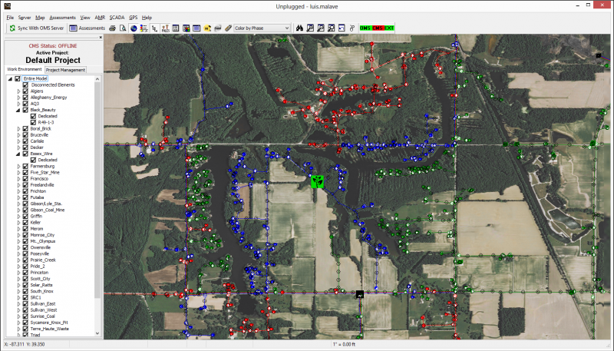
A Real Distribution System
System Information
Geographic Information System (GIS) can utilize detailed geographical information of a practical network to build the consistent system in the software.
ECpE Department

Slide 11
A Real Distribution System
System Information
Substations | 2
Substation Transformers | 4
Regulators | 4
Feeders | 14
Total Feeder Length | 83 miles
# of Overhead Line Sections | 1489
# of Underground Cable Sections | 2582
Capacitor Banks | 5
Switches | 361
ECpE Department

Slide 12
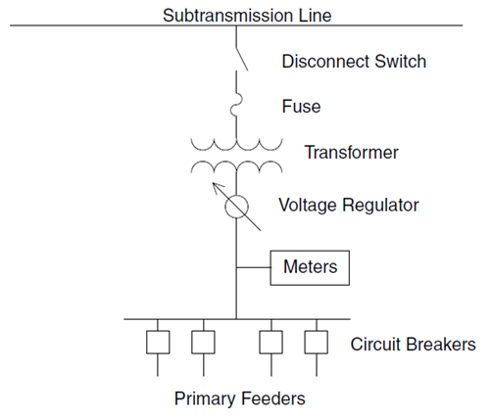
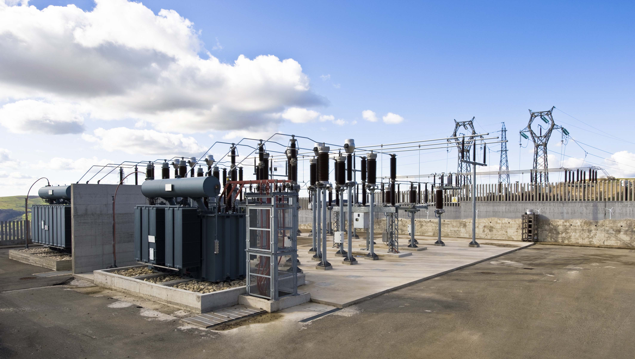
A Real Distribution System
System Information
Substation
The function of a distribution substation is to ‘step down’ high voltage electricity from the transmission or sub-transmission system to lower voltage electricity, so it can be easily supplied to homes and businesses through the distribution lines.
Devices:
Substation transformer
Voltage Regulator
Disconnect Switch
Circuit breaker
Fuse
https://www.qualitrolcorp.com/grid-applications/transmission-distribution/
ECpE Department

Slide 13
A Real Distribution System
System Information
Substation
There are four main functions of a distribution substation:
Voltage transformation:
  One or more transformers will always be located within the substation to step down the voltage to the primary distribution voltage level.
  These transformers will normally be three-phase banks, or they will be three single-phase banks connected in a three-phase configuration.
  Generally, the voltage levels of incoming lines are 69 kV, 115 kV and 138 kV. The output voltage levels include 4.16kV, 7.2kV, 12.47kV, 13.2kV, 14.4kV, 23.9kV, and 34.5kV.
http://home.eng.iastate.edu/~jdm/index.htm
ECpE Department

Slide 14
A Real Distribution System
System Information
Substation
Switching and protection: Different kinds of switchgear will be located at the substation, including switches, circuit breakers, reclosers, and fuses.
Voltage regulation: Because the current flows from source to load along the feeder, and because the feeder has some amount of impedance, the feeder will cause a voltage drop. As a result, we must regulate the voltage along the feeder as the load varies. Ways to do this include substation load tap-changing transformers (LTCs), voltage regulators, and fixed or switched shunt capacitors.
http://home.eng.iastate.edu/~jdm/index.htm
ECpE Department

Slide 15
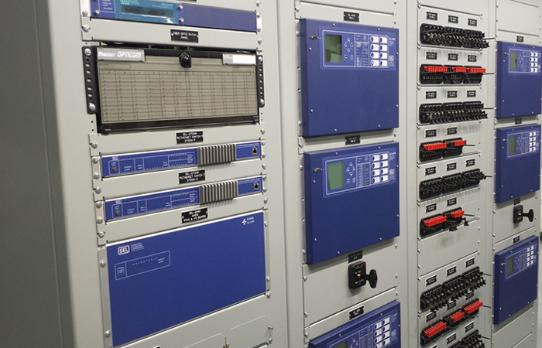
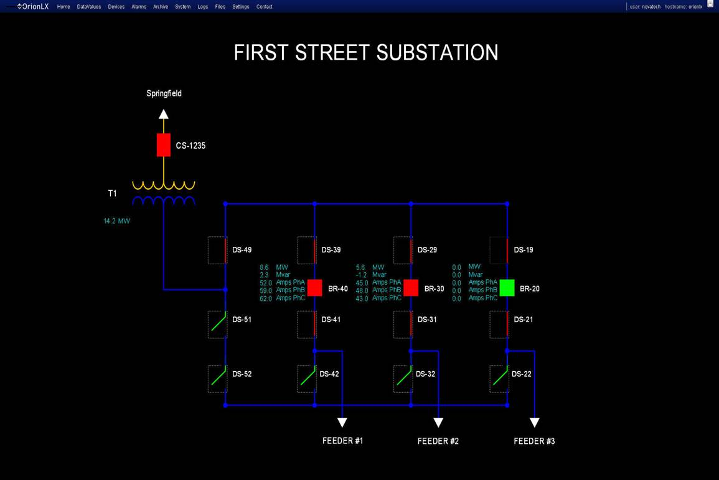
A Real Distribution System
System Information
Substation
Metering: Most substations have some sort of metering devices that record currents, voltages and powers of some specific electric devices. Digital recording is also heavily used and capable of recording a large amount of substation operational information.
http://www.myerspowerproducts.com/index.php?option=com_content&view=category&id=167&Itemid=378&lang=en
https://www.novatechweb.com/substation-automation/web-server-hmi/
ECpE Department

Slide 16
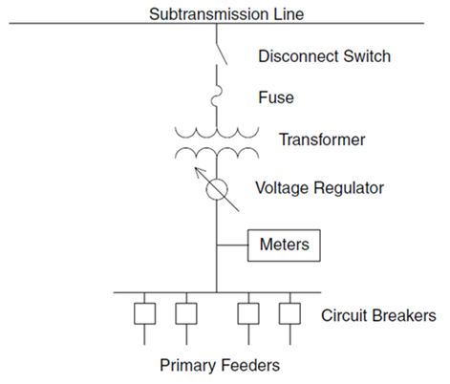
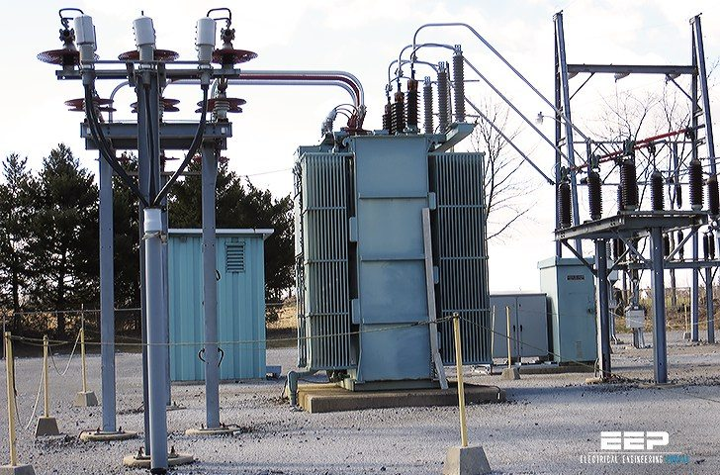
A Real Distribution System
System Information
Substation transformer (Ch. 8)
Substation transformers provide the conversion from sub-transmission circuits to the distribution primary. Most substation transformers are connected as delta – grounded wye, to provide a ground source for the distribution neutral and to isolate the distribution ground system from the sub-transmission system.
Substation transformers are always three-phase installations. They are always in the step-down configuration.
https://electrical-engineering-portal.com/distribution-substation
ECpE Department

Slide 17
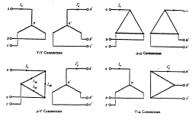
A Real Distribution System
System Information
Substation transformer
The ratings of substation tranformers generally fall within the range of 500 kVA (5 MVA) in smaller rural substations to over 8000 kVA (80 MVA) at urban substations.
There are two basic transformer designs: three interconnected single phase transformers and one three-phase transformer.
Four type of connections: Y-Y, Δ-Δ, Δ-Y, Y-Δ
 | Substation 1 |  | Substation 2
 | Transformer 1 | Transformer 2 | Transformer 1 | Transformer 2
kV rating | 69/13.8 kV | 69/13.8 kV | 69/13.8 kV | 69/13.8 kV
kVA rating | 10,000 kVA | 10,000 kVA | 10,000 kVA | 10,000 kVA
Connection | Delta-Wye | Delta-Wye | Delta-Wye | Delta-Wye
% Imp | 6.39% | 7.71% | 7.59% | 7.67%
X/R | 5 | 5 | 5 | 5
ECpE Department

Slide 18
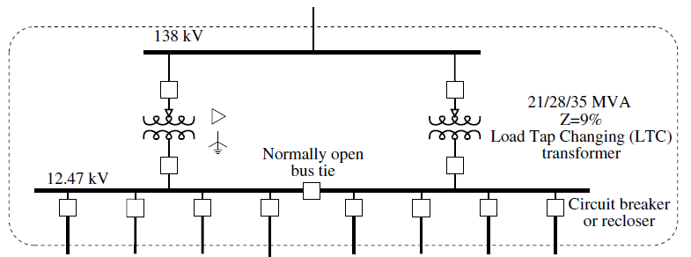
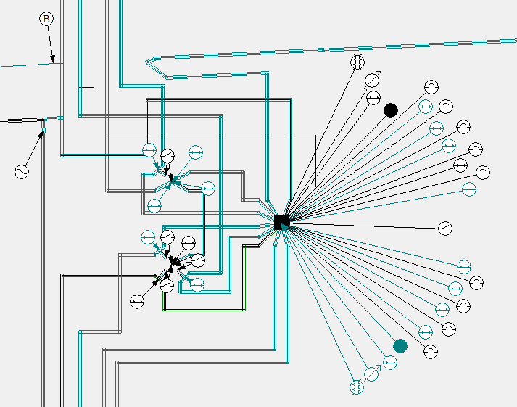
A Real Distribution System
System Information
Substation transformer
Generally, to achieve high reliability, the design in the figure below is implemented.
This type of design provides that all feeders can remain supplied for a transformer outage (caused by maintenance or fault), by switching on certain normally-open switches or circuit breakers.
Momentary parallel operation during switching is often permissible but must be avoided for the extended operation time due to the high secondary currents.
ECpE Department

Slide 19
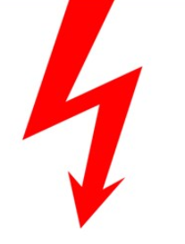
A Real Distribution System
System Information
Substation transformer
Switch on
ECpE Department

Slide 20
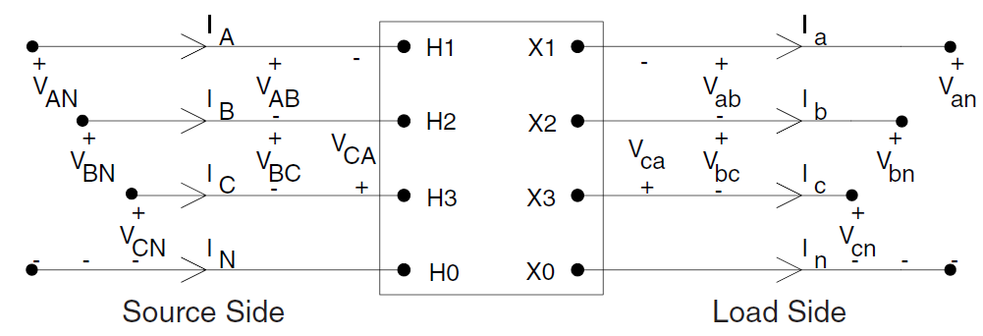
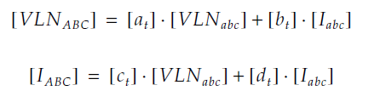
A Real Distribution System
System Information
Substation transformer
General transformer model:
The figure above defines the various voltages and currents for all transformer banks connected between the source side Node n and the load side Node m. This model can represent a step-down or a step-up transformer bank.
The generalized matrix equations for computing the voltages and currents at Node n as a function of the voltages and currents at Node m are given by:
ECpE Department

Slide 21

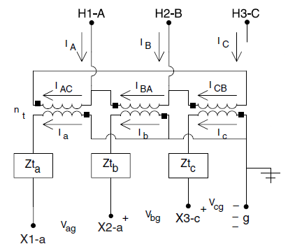
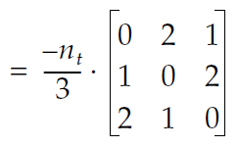
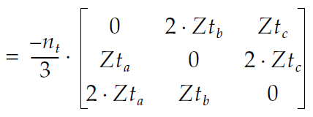


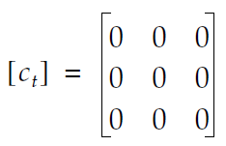
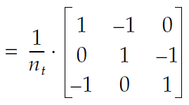

A Real Distribution System
System Information
Substation transformer
For a specific delta-grounded wye step-down connection transformer, we have the following model and parameters
n_{t} is the turns ratio. Zt_{a} , Zt_{b ,} and Zt_{c} are the impedances of phase A, phase B and phase C, respectively.
It can be seen that a_{t}, b_{t}, c_{t} and d_{t} depend on n_{t}, Zt_{a} , Zt_{b ,} Zt_{c} , i.e., depend on the specific winding connection, impedance and rating of a transformer.
ECpE Department

Slide 22
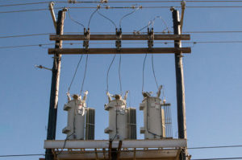
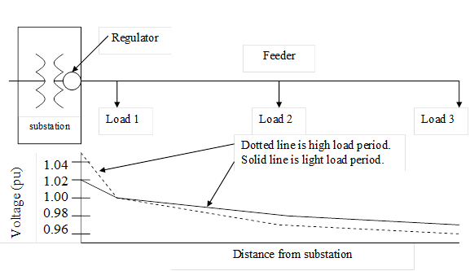
A Real Distribution System
System Information
Voltage Regulator (Ch. 7)
The purpose of a voltage regulator is to keep the voltage in a circuit relatively close to a desired value.
As mentioned earlier, the voltage along a radial feeder decreases with the distance from the substation, because of the feeder voltage drop caused by the load current. That’s why we need voltage regulation.
ECpE Department

Slide 23
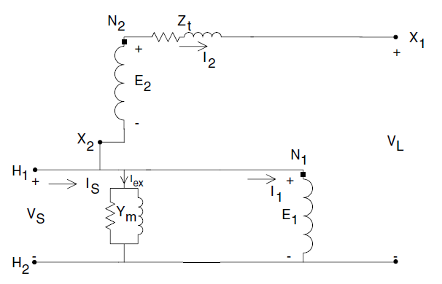
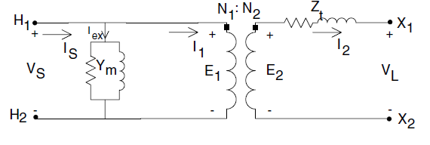
A Real Distribution System
System Information
Voltage Regulator
Generally, there are two types of voltage regulators:
Step voltage regulator: It is a special transformer called an autotransformer, which has the ability to automatically change its turns ratio. It can be placed anywhere along the feeder.
Load tap changer: it is similar to a step voltage regulator, but it is always in the substation.
A step-voltage regulator consists of an autotransformer and a load tap changing mechanism. First, let’s talk about the autotransformer. A two-winding transformer can be connected as an autotransformer, by changing its connection. For example, connecting the high-voltage terminal H1 to the low-voltage terminal X2 can create a “step-up” autotransformer.
A two-winding transformer
Step-up autotransformer
ECpE Department

Slide 24
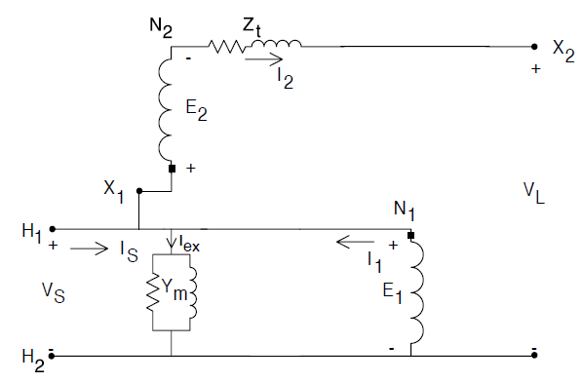


A Real Distribution System
System Information
Voltage Regulator
A step-down autotransformer can be created by reversing the connection between the shunt and series winding in a step-up auto-transformer.
Step-up autotransformer
Step-down autotransformer
The generalized equations of substation transformers also applies to autotransformers.
ECpE Department

Slide 25
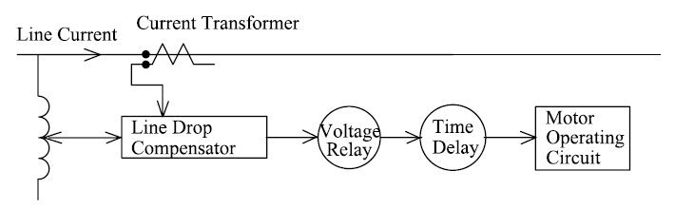
A Real Distribution System
System Information
Voltage Regulator
As mentioned earlier, a step-voltage regulator consists of an autotransformer and a load tap changing mechanism. The voltage change is obtained by changing the taps of the series winding of the autotransformer. The position of the tap is determined by a control circuit (line drop compensator).
The block diagram below shows the circuit that controls tap changing on a step-voltage regulator.
Step-voltage regulator control circuit.
ECpE Department

Slide 26
A Real Distribution System
System Information
Voltage Regulator
Voltage Level: the desired voltage (on a 120-V base) to be held at the load center.
Bandwidth: the allowed variance of the load center voltage from the set voltage level. The voltage held at the load center will be ± one half the bandwidth.
Time Delay: length of time that a raise or lower operation is called for before the actual execution of the command. This prevents taps changing during a transient or short time change in current.
Line Drop Compensator: Set to compensate for the voltage drop (line drop) between the regulator and the load center. The settings consist of R and X settings in volts, which are corresponding to the equivalent impedance between the regulator and the load center. This setting may be zero if the regulator output terminals are the load center.
Generally, standard step-voltage regulators contain a reversing switch enabling a ±10% regulator range.
Note that the required rating of a step-voltage regulator is based upon the kVA transformed, not the kVA rating of the line. In general, this will be 10% of the line rating since rated current flows through the series winding which represents the ±10% voltage change.
ECpE Department

Slide 27
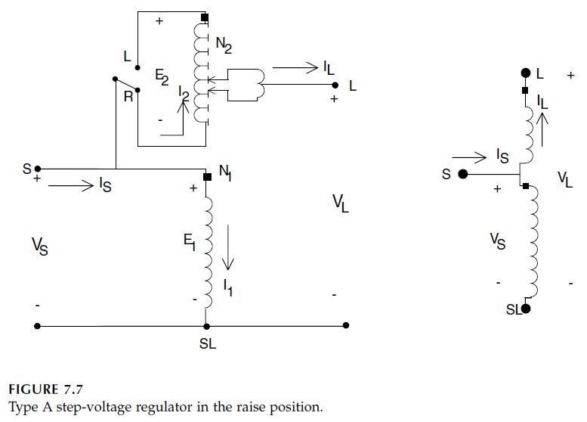
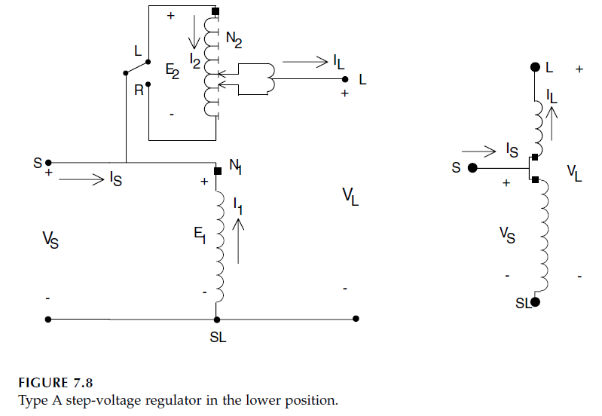
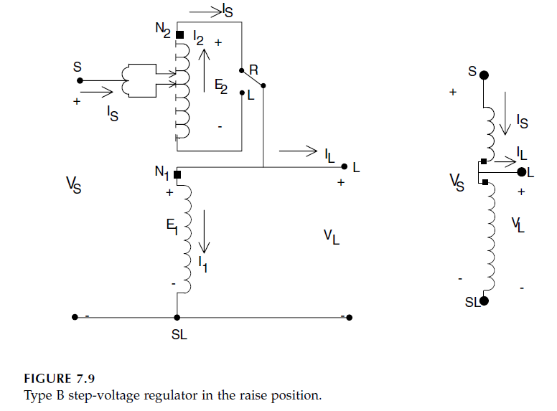
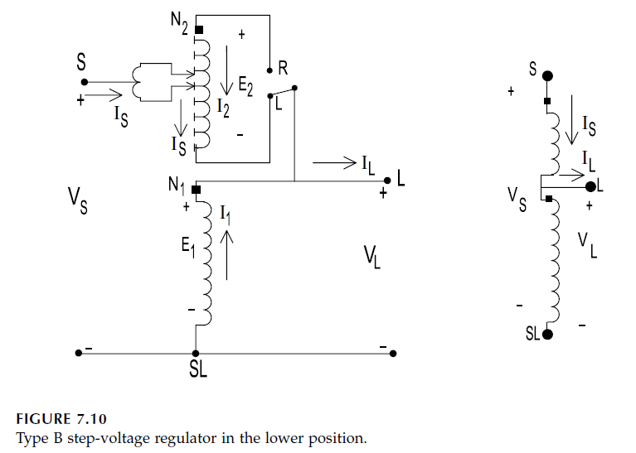
A Real Distribution System
System Information
Voltage Regulator
Two types of step voltage regulators:
(1) Type A
(2) Type B
ECpE Department

Slide 28
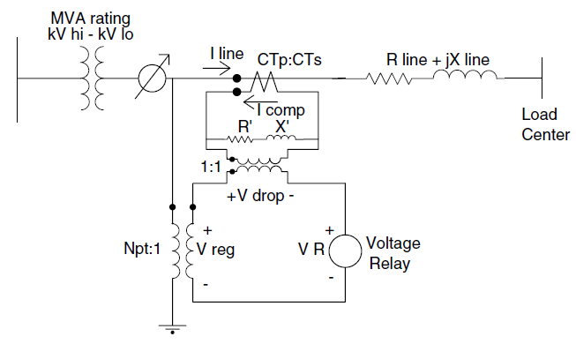
A Real Distribution System
System Information
Voltage Regulator
The line drop compensator:
The changing of taps on a volatge regulator is controlled by the line drop compensator.
This figure shows a simplified sketch of a compensator circuit and how it is connected to the distribution line through a potential transformer and a current transformer.
The purpose of the line drop compensator is to model the voltage drop of the distribution line from the regulator to the load center.
Line drop compensator circuit.
ECpE Department

Slide 29
A Real Distribution System
System Information
Voltage Regulator
R’, X’ and VR are needed to set.
Line drop compensator circuit.
CTp: primary current rating, typically be the rated current of the feeder,
CTs: secondary rated current of the current transformer, usually 5 A
CTp:CTs: the current transformer turns ratio,
R’: R settings in volts,
X’: X settings in volts,
Npt: the turns ratio of the potential transformer,
Vreg: the input voltage to the compensator,
V_{R} : desired voltage.
ECpE Department

Slide 30
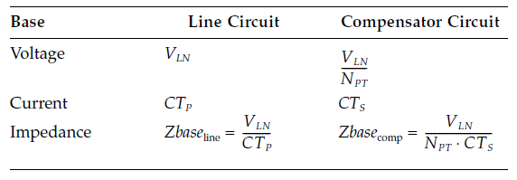




A Real Distribution System
System Information
Voltage Regulator
Generally, R and X setting of the line volatge drop are in terms of volts (R’ and X’), to estimate them, first, calculate the base impedance values both in the line and in the compensator
With the computed base values, the compensator R and X settings in ohms can be calculated by first computing the per-unit line impedance:
The compensator impedance in ohms is computed by multiplying the per-unit impedance by the base compensator impedance:
ECpE Department

Slide 31


A Real Distribution System
System Information
Voltage Regulator
The compensator R and X settings in volts are determined by multiplying the compensator R and X in ohms times the rated secondary current in amps (CT_{S}) of the current transformer:
Parameters of the load tap changer:
 | Substation 1 |  | Substation 2
 | LTC 1 | LTC 2 | LTC 1 | LTC 2
kV rating | 13.8 kV | 13.8 kV | 13.8 kV | 13.8 kV
kVA rating | 10.5 MVA | 10.5 MVA | 10.5 MVA | 10.5 MVA
Connection | Wye-Wye | Wye-Wye | Wye-Wye | Wye-Wye
% Boost | 10.00% | 10.00% | 10.00% | 10.00%
Number of steps | 16 | 16 | 16 | 16
Voltage bandwdith (volt) | 2 | 2 | 2 | 2
CTp (A) | 439 | 439 | 439 | 439
ECpE Department

Slide 32
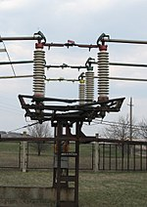
A Real Distribution System
System Information
Disconnect Switch
Disconnect switch is one type of switching devices.
Switching devices are used to close or open electrical circuits. The types of switching devices include:
    Circuit breaker -- makes and breaks all currents, including normal currents and short-circuit currents
    Switch -- makes and breaks currents that are smaller than the rated normal current
    Disconnect switch (disconnector) – used for no-load closing and opening operation
    Switch disconnector -- the combination of a switch and a disconnector
    Fuse -- consists of a fuse base and a fuse link. The fuse link is used for one single breaking of a short circuit current.
https://electrical-engineering-portal.com/medium-voltage-switchgear-basics-of-switching-devices
ECpE Department

Slide 33
A Real Distribution System
System Information
Disconnect Switch
The purpose of disconnect switches in substations is to allow isolation of apparatus such as circuit breakers, transformers, and transmission lines, for maintenance.
The disconnect switch is usually not intended for normal control of the circuit, but only for safety isolation, since it lacks a mechanism for suppression of electric arcs, which occurs when conductors carrying high currents are electrically interrupted.
Thus, they are off-load devices, with very low breaking capacity, intended to be opened only after current has been interrupted by some other control devices, such as circuit breaker.
While opening a circuit, the below sequence should be followed
While making a circuit, the below sequence should be followed
Open the circuit breaker
Open the disconnect switch
Close the disconnect switch
Close the circuit breaker
ECpE Department

Slide 34
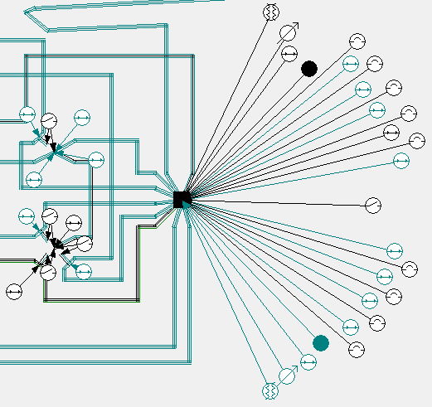
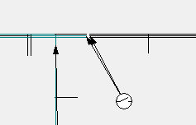
A Real Distribution System
System Information
Disconnect Switch
In the real distribution system, there are 24 disconnect switches in substation 1.
Some are normally open, some are normally closed.
In general, circuit breaker-disconnect switch pairs are used for making or opening circuits.
There are also some in-line switches (e.g. circuit breakers), which are used for system protection and re-configurations.
ECpE Department

Slide 35
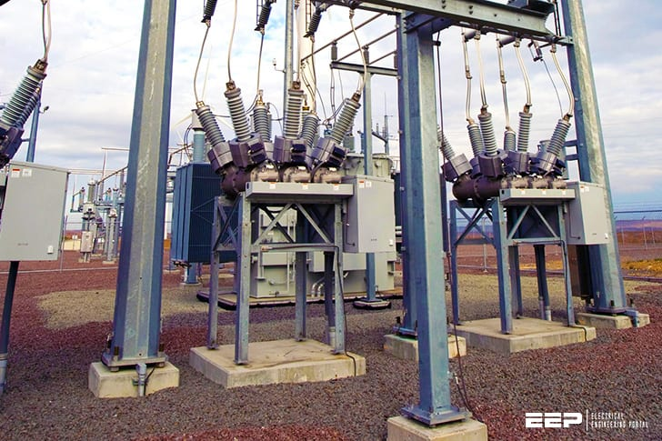
A Real Distribution System
System Information
Circuit Breaker
Circuit breakers are often used in the substation on the bus and on each feeder.
Circuit breakers are available with very high interrupting and continuous current ratings.
The interrupting medium in circuit breakers can be any of vacuum, oil, or air, etc. Oil and vacuum breakers are most common in distribution substations.
Circuit breakers are always paired with relays which sense short-circuit condition using potential transformers (PTs) and current transformers (CTs). The relays provide the brains to control the opening or closing of the circuit breaker, so the circuit breaker coordinates with other devices. While closing a circuit breaker, the relays perform reclosing functions.
https://electrical-engineering-portal.com/substation-basics#circuit-breakers
ECpE Department

Slide 36
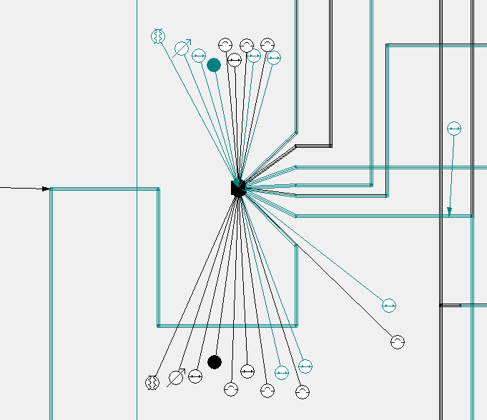
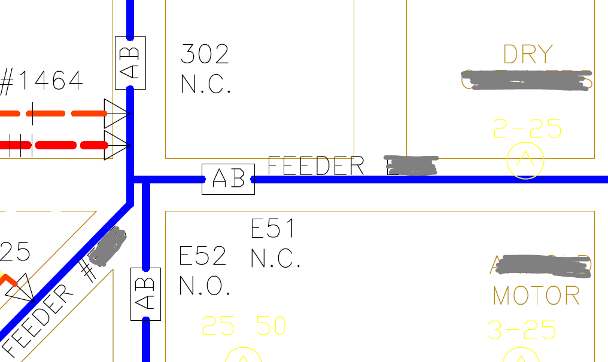
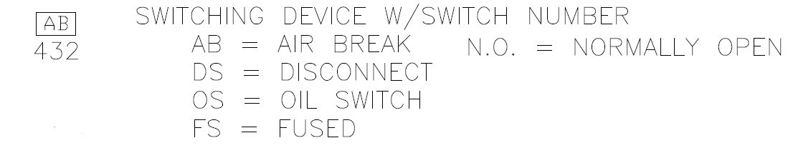
A Real Distribution System
System Information
Circuit Breaker
In substation 1, there are 9 feeder circuit breakers.
In substation 2, there are 5 feeder circuit breakers.
ECpE Department

Slide 37
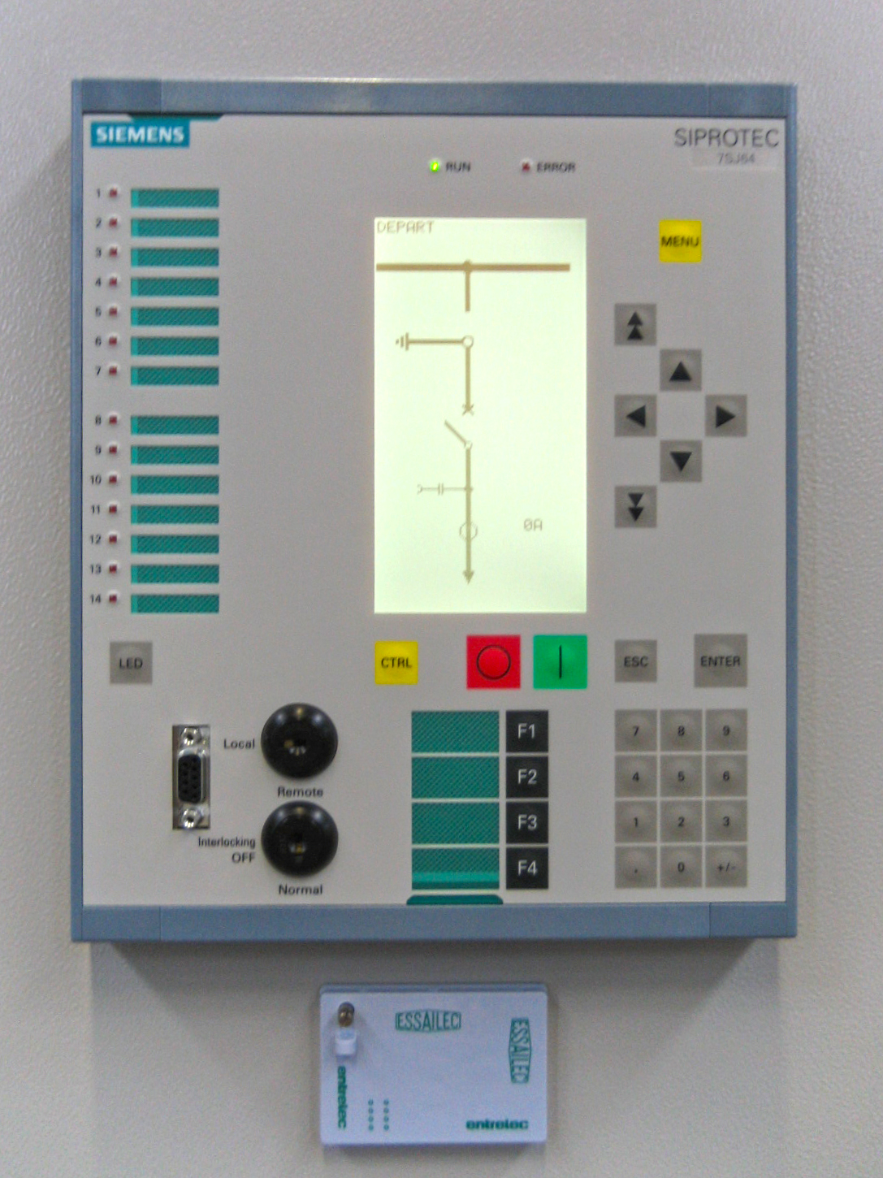
A Real Distribution System
System Information
Relay
Relays are used for controlling distribution circuit breakers. The basic idea is that if the short-circuit current (or other measurements) exceeds a preset value and remains higher for longer than the delay time set, the relay will trip the circuit breaker.
Distribution circuits are almost always protected by overcurrent relays that use inverse time-current characteristics. Also, instantaneous relay trip is implemented by utilities, although not common.
The main types of relays include
  Electromechanical relay
  Static relay
  Digital relay — A most modern relay technology which is fully digital based on microprocessor components.
https://en.wikipedia.org/wiki/Digital_protective_relay
ECpE Department

Slide 38
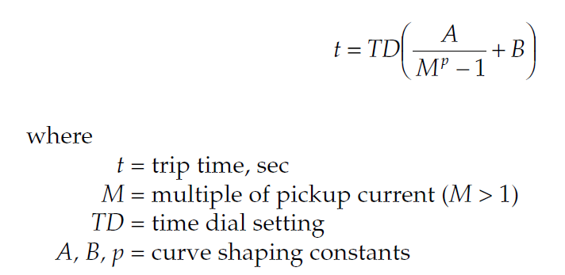
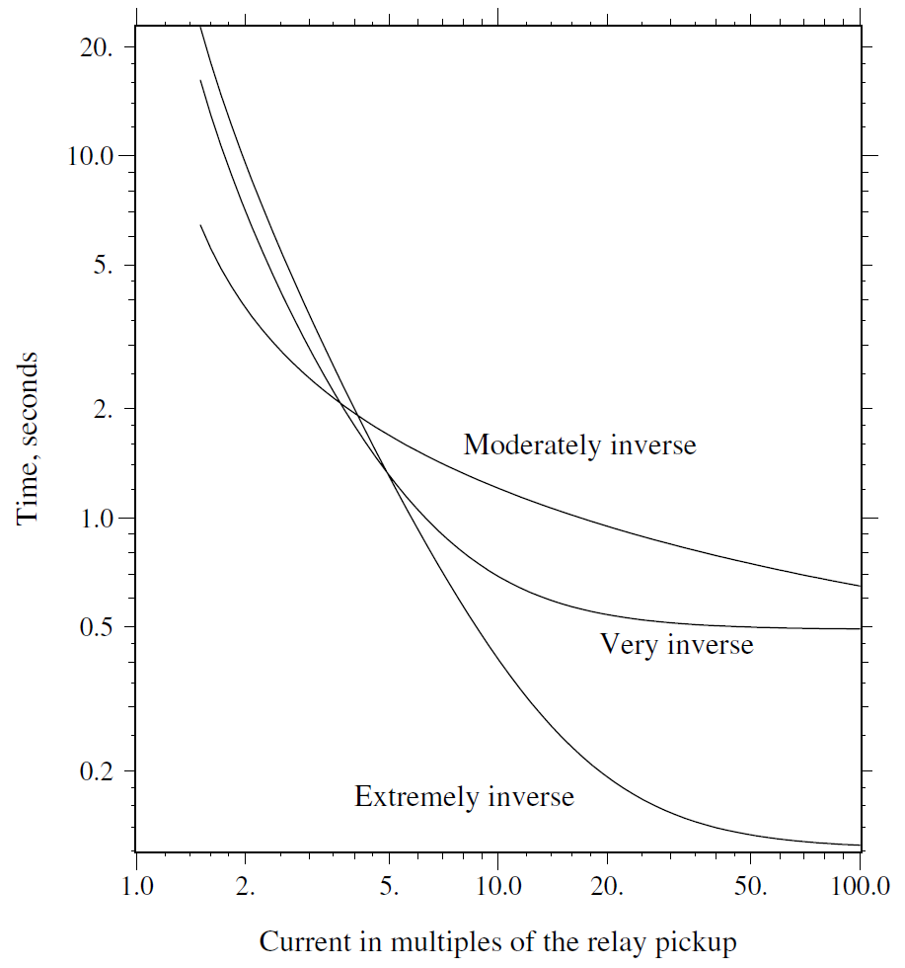
A Real Distribution System
System Information
Relay
An inverse time-current characteristic means that the relay will operate faster with increased current.
Inverse time-current characteristic is expressed as
The higher the short-circuit current, the faster a relay trips.
M = short-circuit current/current setting
ECpE Department

Slide 39
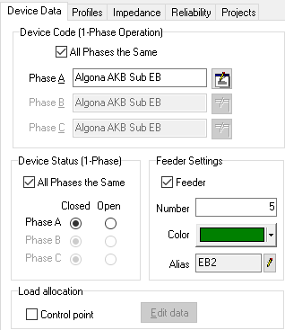
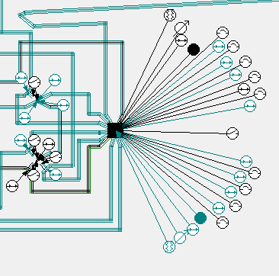
A Real Distribution System
System Information
Relay
In the real distribution system, there is no separate relay devices for the circuit breakers, the functions of relays are performed by reclosers.
ECpE Department

Slide 40
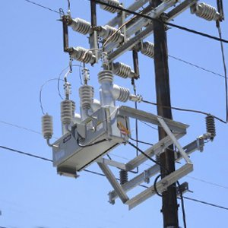
A Real Distribution System
System Information
Recloser
Recloser is a self-controlled device for automatically interrupting and reclosing an AC circuit, with a predetermined sequence of opening and reclosing.
Like a circuit breaker, a recloser can be used for interrupting currents. The interrupting medium of a recloser is most commonly vacuum or oil.
The recloser control can be electronic, electromechanical or hydraulic. A hydraulic recloser uses springs and hydraulic systems for timing and actuation.
In short, a recloser is a circuit breaker which is integrated with a relay and a reclosing control element.
Temporary fault
A fault occurs
The recloser opens the circuit
The recloser reclose the circuit
Success, keep closed
Permanent fault
Reopen, reclose, until finally open the circuit
https://www.arteche.com/en/reclosers-and-switches
ECpE Department

Slide 41
A Real Distribution System
System Information
Recloser
Why do we need the function of reclosing?
Automatic reclosing is motivated by the fact that about 60-80% of all overhead distribution faults are temporary and last only a few cycles or a few seconds. For example, a branch may blow against a circuit and then fall to the ground. As a result, it becomes very attractive to reclose following an initial opening of the protection device.
Reclosers have many distribution applications.
It can be used in the substation as feeder interrupters instead of circuit breakers. Reclosers are used more in smaller stations and circuit breakers more in larger stations.
Three-phase reclosers can be used on the main feeder to provide necessary protection coverage on longer circuits, along with improved reliability.
Reclosers are available as single-phase units, so they can be used on single-phase taps (laterals) instead of fuses.
Another common application is in auto-loop automation schemes to automatically sectionalize customers after a fault.
Three-phase reclosers are available that can operate each phase independently (so a single-phase fault will only open one phase).
ECpE Department

Slide 42
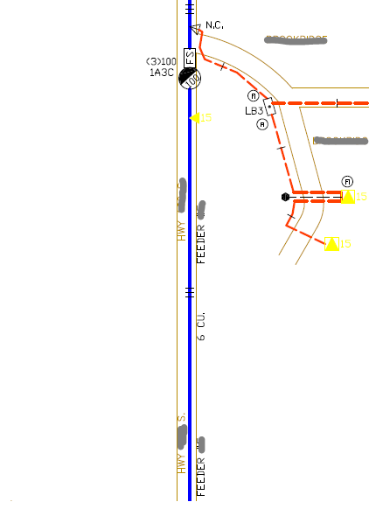
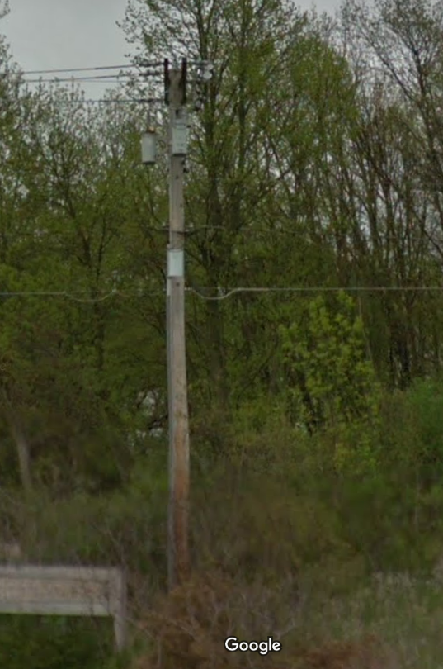
A Real Distribution System
System Information
Recloser
The real corresponding picture from Google Map
Current rating
ECpE Department

Slide 43
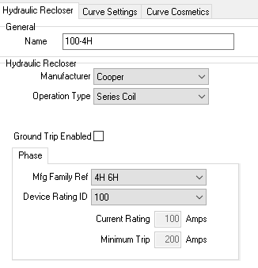
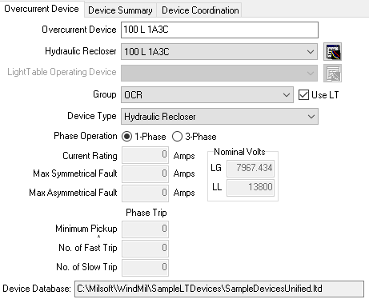
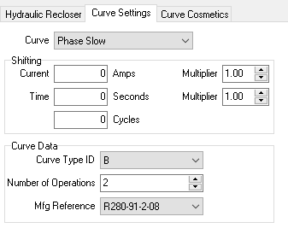
A Real Distribution System
System Information
Recloser
ECpE Department

Slide 44



A Real Distribution System
System Information
Fuse
Fuses have elements that melt if enough current flows through it for enough time.
They are inexpensive, and can open very fast for high currents.
The most common type of fuses is the expulsion type within a cutout. A cutout is used to support the fuse and enable efficient replacement when it is blown.
https://www.osha.gov/SLTC/etools/electric_power/illustrated_glossary/substation_equipment/high_voltage_fuses.html
https://www.eng-tips.com/viewthread.cfm?qid=442197
ECpE Department

Slide 45

A Real Distribution System
System Information
Fuse
The higher the short-circuit current, the faster a fuse melts.
Some characteristics of the fuse:
Interruption is relatively fast and can occur in a half of a cycle for large currents.
The I²t value of a fuse is often needed to coordinate between fuses. For the same current, fuses with larger I²t value melt slower than fuses with smaller I²t value.
Industry standards specify two types of expulsion fuses.
  K-type: fast fuse with speed ratio of 6-8
  T-type: slower fuse with speed ratio of 10-13
The speed ratio is the ratio of
  The melting current at 0.1 second to
  the melting current at X seconds, where X is 300 for fuse ratings below 100 amps and X is 600 for fuse ratings above 100 amps.
  The current rating is the level of current the fuse can safely carry for an indefinite period of time.
ECpE Department

Slide 46



A Real Distribution System
System Information
Fuse
A lateral supplying a Fareway market. Fuses are installed at the head of the lateral for protection.
Real corresponding picture from Google Map
ECpE Department

Slide 47


A Real Distribution System
System Information
Primary Distribution System
The primary distribution system consists of the feeders emanating from the substation and supplying power to one or more secondary distribution systems. Normally, primary feeders are 3-phase circuits.
https://www.gegridsolutions.com/multilin/resource/Feeder/UniFlip_Publication/document.pdf
Feeders are almost always radial from substation to loads (i.e., one way flow of power) in rural areas, usually radial in residential neighborhoods, and they are often radial even in urban areas. In densely populated urban areas, particularly commercial and business districts where reliability is critical, feeders may be looped.
ECpE Department

Slide 48



A Real Distribution System
System Information
Primary Distribution System -- Overhead Line
There are two types of primary feeders, overhead line and underground cable.
Overhead line:
Along streets, alleys, through woods, and in backyards, many of the distribution lines that feed customers are overhead structures.
Because overhead lines are exposed to trees and animals, to wind and lightning, and to cars and kites, they are a critical component in the reliability of distribution circuits.
Some typical constructions:
T.A. Short, Electric power distribution handbook
(a) Three-phase 34.5-kV armless construction with covered wire.
(b) Single-phase circuit, line-to-ground 7.2 kV.
(c) Single-phase circuit, 4.8-kV.
ECpE Department

Slide 49




A Real Distribution System
System Information
Primary Distribution System -- Overhead Line
Conductor:
Definition of wire: A wire is metal drawn or rolled to long lengths, normally understood to be a solid wire. Wires may or may not be insulated. A conductor is one or more wires suitable for carrying electric current. Often the term conductor is used to mean wire.
Most conductors are either aluminum or copper. Utilities use aluminum for almost all new overhead installations. Aluminum is lighter and less expensive for a given current-carrying capability. Copper was installed more in the past, so significant lengths of copper are still in service on overhead circuits.
Aluminum conductor steel-reinforced cable(ACSR)
Copper
https://www.okonite.com/product-catalog/section-2/
ECpE Department

Slide 50

A Real Distribution System
System Information
Primary Distribution System -- Underground Cable
Underground cable:
Much new distribution is underground. Underground cable is much more hidden from view than overhead circuits, and is more reliable.
However, an underground circuit typically costs anywhere from 1 to 2.5 times the equivalent overhead circuit.
There are seven distinguishing features with regards to cable construction:
Single phase vs. polyphaser
Neutral
Conductor
Insulation
Shielding
Jackets
Burial
https://www.osha.gov/SLTC/etools/electric_power/illustrated_glossary/substation.html
ECpE Department

Slide 51


A Real Distribution System
System Information
Primary Distribution System -- Underground Cable
Single phase vs. polyphaser
Cables may have 1, 2, 3, or 4 conductors. Use of multiple conductors saves money, as only 1 shield and 1 jacket is needed and they are easier to install.
T.A. Short, Electric power distribution handbook
ECpE Department

Slide 52

A Real Distribution System
System Information
Primary Distribution System -- Underground Cable
Neutral
The neutral may be non-concentric or concentric. The non-concentric neutral typically has only a single neutral wire. Concentric neutrals, on the other hand, have neutral wires wound helically around the insulation shield.
non-concentric
concentric
T.A. Short, Electric power distribution handbook
https://solutions.borderstates.com/whats-the-difference-between-epr-and-tr-xlp-cable/
ECpE Department

Slide 53
A Real Distribution System
System Information
Primary Distribution System -- Underground Cable
Conductor
Like the overhead lines, conductors may be copper or aluminum for underground cables. Copper is a slightly better conductor than aluminum (lower resistivity) and therefore the same ampacity can be achieved with a lower diameter cable.
Insulation
There are three basic types of cable insulation in use today: paper, plastic compounds, rubber or rubber-like compounds.
Shielding
The shield is a conducting layer surrounding another part of the cable.
Jackets
The jacket is also referred to as the armor, and like this latter name suggests, its function is to provide physical protection from environmental and installation conditions.
T.A. Short, Electric power distribution handbook
ECpE Department

Slide 54

A Real Distribution System
System Information
Primary Distribution System -- Underground Cable
ECpE Department
Notes:
Operations & Maintenance

Slide 55









A Real Distribution System
System Information
Primary Distribution System
Line Model:
The figure above shows an exact model of a three-phase, two-phase, or single-phase overhead or underground line. When a line segment is two-phase (V-phase) or single-phase, some of the impedance and admittance values will be zero.
The two equations relating the input (Node n) voltages and currents to the output (Node m) voltages and currents are as follows:
U – Identity matrix
Yabc – Shunt admittance matrix
Zabc – Series impedance matrix
ECpE Department
Notes:
Two-port network

Slide 56

A Real Distribution System
System Information
Primary Distribution System
Line Model:
To calculate Zabc matrix, first, we calculate the self and mutual impedances of all conductors, using the conductor and construction information. The two equations for calculating self and mutual impedances are as follows
$\hat{z_{ii}}=r_{i}+0.09530+j0.12134(\ln{\frac{1}{{GMR}_{i}}}+7.93402$) $Ω\text{/}\text{mile}$ (4.41)
$\hat{z_{ij}}=0.09530+j0.12134(\ln{\frac{1}{D_{ij}}}+7.93402\text{)}Ω\text{/}\text{mile}$ (4.42)
Then, a primitive impedance matrix is built using the calcualted self- and mutual-impedances:
ECpE Department

Slide 57




A Real Distribution System
System Information
Primary Distribution System
Line Model:
After that, the primitive impedance matrix is partitioned into four matrices:
Finally, the primitive impedance matrix is reduced to a 3*3 phase frame matrix consisting of the self and mutual equivalent impedances for the three phases
ECpE Department

Slide 58



A Real Distribution System
System Information
Primary Distribution System
Line Model:
To calculate Yabc matrix of an overhead line, first, we calculate the self and mutual potential coefficients using conductor and construction information. The two equations used for calculating self and mutual potential coefficients are as follows:
Then, the primitive potential coefficient matrix is built as
S_{ii} = distance from Conductor i to its image i’ (ft.)
S_{ij} = distance from Conductor i to the image of Conductor j (ft.)
D_{ij} = distance from Conductor i to Conductor j (ft.)
RD_{i}= radius of Conductor i in ft.
ECpE Department

Slide 59




A Real Distribution System
System Information
Primary Distribution System
Line Model:
Then, the primitive potential coefficient matrix is partitioned into four matrices
After that the primitive coefficient matrix is reduced using the Kron reduction method to a 3*3 phase potential coefficient matrix
The inverse of the potential coefficient matrix will give us the capacitance matrix
The admittance matrix is given by multiplying Cabc with 2 $πf$
$Y_{abc}=$ $2π{f C}_{abc}$
ECpE Department

Slide 60


A Real Distribution System
System Information
Primary Distribution System
Line Model:
For underground cables, the calculation of shunt admittance matrix is slightly different from that of overhead lines.
dc = diameter of phase conductor
ds = diameter of neutral conductor
dod = overall diameter of cable
ECpE Department

Slide 61






A Real Distribution System
System Information
Primary Distribution System
Line Model:
First, the radius of the phase conductor is calculated by dividing the diameter of phase conductor by 2:
${RD}_{c}$=$d_{c} /2$
Then, the radius of the strand conductor is calculated by diving the diameter of the strand conductor by 2 :
${RD}_{s}$=$d_{s} /2$
Then, the radius of the cable is calculated using the overall diameter of the cable and the diameter of strand conductor:
$R$=${(d}_{od}−d_{s}) /2$
After that, the capacitance from phase to ground for a concentric neutral cable, Cpg, is calculated:
$C_{pg}=\frac{2πε}{\ln\left(R/{{RD}_{c}}\right)−(1/k)\ln{(k∗{{RD}_{s}}/R)}}$
Then, the phase admittance for a concentric neutral cable is given by multiplying the capacitance with 2𝜋𝑓:
$y_{pg}=$ $2π{fC}_{pg}$
Finally, the shunt admittance matrix for this three-phase underground cable is obtained by putting the three phase admittances together:
ε = permittivity of the medium
k = number of strands
dc = diameter of phase conductor
ds = diameter of neutral conductor
dod = overall diameter of cable
$$y_{abc}=\left[\begin{matrix}y_{ag} & 0 & 0 \\ 0 & y_{bg} & 0 \\ 0 & 0 & y_{cg}\end{matrix}\right]$$
ECpE Department

Slide 62



A Real Distribution System
System Information
Primary Distribution System -- Underground Cable
ECpE Department

Slide 63


A Real Distribution System
System Information
Capacitor Bank (Ch. 9)
Capacitors provide tremendous benefits to distribution system performance.
Capacitors can reduce losses, free up capacity, and reduce voltage drop.
  Losses; Capacity — By canceling the reactive power to motors and other loads with low power factor, capacitors decrease the line current. Reduced current frees up capacity, i.e., the same circuit can serve more load. Reduced current also significantly lowers the I²R line losses.
  Voltage drop — Capacitors provide a voltage boost, which cancels part of the voltage drop caused by system loads.
https://www.eaton.com/us/en-us/catalog/medium-voltage-power-distribution-control-systems/pole-mounted-capacitor-banks.html
ECpE Department

Slide 64




A Real Distribution System
System Information
Capacitor Bank (Ch. 9)
Two types of connection: wye and delta.
ECpE Department

Slide 65



A Real Distribution System
System Information
Capacitor Bank (Ch. 9)
In the real distribution system, there are 5 capacitor banks.
Real corresponding picture from Google Map
ECpE Department

Slide 66

A Real Distribution System
System Information
Secondary Distribution System (Ch. 11)
Secondary distribution system is an AC power distribution system in which customers are served.
The secondary circuit is supplied by distribution transformers. The standard secondary voltage levels are
• 120/240 single-phase
• 120/208 three-phase
• 277/480 three-phase
Tony Samaritano, Power Systems, Rowan University 2012
ECpE Department

Slide 67


A Real Distribution System
System Information
Secondary Distribution System -- Distribution Transformer
The distribution transformer normally serves as the final transition to the customers and often provides a local grounding reference. Most distribution circuits have hundreds of distribution transformers.
Distribution feeders may also have other transformers: voltage regulators, feeder step banks, and grounding banks.
https://metglas.com/distribution-transformer-electrical-steel/three-white-distribution-transformers-on-pole-with-light-blue-sky/
ECpE Department

Slide 68


A Real Distribution System
System Information
Secondary Distribution System -- Distribution Transformer
From a few kVA to a few MVA, distribution transformers convert primary voltage to low voltage that customers can use. In North America, more than 40 million distribution transformers are in service.
Distribution transformers are available in several standardized sizes as shown in Table below.
Most installations are single phase. The most common overhead transformer is the 25-kVA unit; pad-mounted transformers tend to be slightly larger where the 50-kVA unit is the most common.
ECpE Department

Slide 69



A Real Distribution System
System Information
Secondary Distribution System -- Distribution Transformer
Three-phase Transformer
Three-phase overhead transformer banks are normally constructed from three single-phase units. Three-phase pad-mounted distribution transformer is a three-phase transformer with one single unit.
https://metglas.com/distribution-transformer-electrical-steel/three-white-distribution-transformers-on-pole-with-light-blue-sky/
https://www.larsonelectronics.com/product/150677/500-kva-pad-mount-transformer-12470v-delta-primary-480grdy-277-wye-n-secondary-oil-cooled
ECpE Department

Slide 70





A Real Distribution System
System Information
Secondary Distribution System -- Distribution Transformer
Three-phase Transformer
There are many types of three-phase connections used to serve three-phase load in distribution systems. Both the primary and secondary windings may be connected in different ways: delta, floating wye, or grounded wye.
ECpE Department

Slide 71
A Real Distribution System
System Information
Secondary Distribution System -- Distribution Transformer
Three-phase Transformer
For the primary winding of three-phase distribution transformers, utilities need to choose proper connections according to the configuration of primary feeders.
  The delta and floating-wye primary connections are suitable for ungrounded and grounded primary distribution systems.
  The grounded-wye primary connection is only suitable on four-wire grounded primary distribution systems.
  Customer needs play a role in the selection of the secondary configuration. The delta configuration and the grounded-wye configuration are the two most common secondary configurations.
  A grounded-wye secondary adeptly handles single-phase loads on any of the three phases with less concerns about unbalances.
  An ungrounded secondary system like the delta can supply three-wire ungrounded service. Some industrial facilities prefer an ungrounded system, so they can continue to operate with line-to-ground faults.
ECpE Department

Slide 72

A Real Distribution System
System Information
Secondary Distribution System -- Distribution Transformer
Three-phase Transformer
The most common three-phase distribution transformer supply connection is the grounded wye – grounded wye connection. Its main characteristics are:
  Supply — The supply must be a grounded 4-wire system
  Service — It supplies grounded-wye service, normally either 480Y/277 V or 208Y/120 V. It does not supply ungrounded service.
  Zero sequence — All zero-sequence currents — harmonics, unbalance, and ground faults — transfer to the primary. It also acts as a high-impedance ground source to the primary.
  Coordination — Because ground faults pass through to the primary, larger transformer services and local protective devices should be coordinated with utility ground relays.
ECpE Department

Slide 73
A Real Distribution System
System Information
Secondary Distribution System -- Distribution Transformer
Three-phase Transformer
For the three-phase distribution transformer, the model of the three-phase substation transformer also applies.
a_{t}, b_{t}, c_{t} and d_{t} depend on the specific winding connection, impedance and rating of a transformer. For example, for a delta-grounded wye step-down connection transformer,
ECpE Department

Slide 74


A Real Distribution System
System Information
Secondary Distribution System -- Distribution Transformer
Single-phase Center-tapped Transformer
Single-phase transformers supply single-phase service.
The standard secondary load service is a 120/240-V three-wire service.
This configuration has two secondary windings in series with the midpoint grounded. The secondary terminals are labeled X1, X2, and X3 where the voltage X1-X2 and X2-X3 are each 120 V. X1-X3 is 240 V.
https://en.wikipedia.org/wiki/Distribution_transformer
ECpE Department

Slide 75









A Real Distribution System
System Information
Secondary Distribution System -- Distribution Transformer
Single-phase Center-tapped Transformer
The single-phase center-tapped transformer model is shown in the figure below.
When the secondary terminal voltages and secondary currents are known, the primary source voltage and current are calculated using these two equations(backward sweep):
[$V_{ss}]=\text{[}a_{t}]·\text{[}V_{12}]+$ $\text{[}b_{t}]·\text{[}I_{12}]$
[$I_{00}]=\text{[}c_{t}]·\text{[}V_{12}]+$ $\text{[}d_{t}]·\text{[}I_{12}]$
[$V_{ss}]=\left[{V_{s} \atop V_{s}}\right]$
$\text{[}a_{t}]= \text{[}av]=$ $n_{t}·\left[{1 \atop 0}{0 \atop 1}\right]$
[$I_{00}]=\left[{I_{0} \atop I_{0}}\right]$
$\text{[}c_{t}]=$ $n_{t}·\left[{0 \atop 0}{0 \atop 0}\right]$
$\text{[}b_{t}]=$ $\left[{n_{t}·Z_{1}+\frac{1}{n_{t}^{2}}·Z_{0} \atop \frac{1}{n_{t}^{2}}·Z_{0}}{ −\frac{1}{n_{t}^{2}}·Z_{0} \atop −(n_{t}·Z_{2}+\frac{1}{n_{t}^{2}}·Z_{0})}\right]$
$\text{[}d_{t}]=$ $\frac{1}{n_{t}}\left[{1 \atop 1}{ −1 \atop −1}\right]$
a_{t}, b_{t}, c_{t} and d_{t} depend on n_{t}, Z₀ , Z_{1 ,} Z₂ , i.e., depend on the specific impedance and winding ratings of a transformer.
ECpE Department

Slide 76


A Real Distribution System
System Information
Secondary Distribution System -- Distribution Transformer
Single-phase Center-tapped Transformer
ECpE Department

Slide 77

A Real Distribution System
System Information
Load (Ch. 9)
Distribution systems obviously exist to supply electricity to end users, so loads and their characteristics are important.
Utilities supply a broad range of loads, from rural areas to urban areas with different load densities.
A utility may feed houses with a 10- to 20-kVA peak load, as an industrial customer peaking at 5 MW.
Customer loads have many common characteristics. Load levels vary through the day, peaking in the afternoon or early evening.
http://waterheatertimer.org/Names-of-parts-on-electric-pole.html
ECpE Department

Slide 78




A Real Distribution System
System Information
Load
According to the load types, load models can be classified into:
Constant impedance
Constant current
Constant active and reactive power
Any combination of the above
According to the load phase configuration, we have
Single-phase load
Two-phase load
Three-phase load
According to the load connection, we have
Wye-connected load
Delta-connected load
ECpE Department

Slide 79



A Real Distribution System
System Information
Load
Two examples:
For a constant active and reactive power, wye-connected load, the line currents are given by
For a constant impedance, wye-connected load, the line currents are given by
ECpE Department

Slide 80

A Real Distribution System
Raw AMI Data
What is AMI?
AMI is the abbreviation of Advanced Metering Infrastructure, which typically refers to the full measurement and collection system that includes
meters at the customer site,
communication networks between the customer and a service provider, such as an electric, gas, or water utility, and
data reception and management systems that make the information available to the service provider.
The customers are equipped with advanced solid state and electronic meters that collect time-based demand data, which is we are interested in.
https://www.ferc.gov/CalendarFiles/20070423091846-EPRI%20-%20Advanced%20Metering.pdf
ECpE Department

Slide 81
A Real Distribution System
Raw AMI Data
Overview of AMI Collection
 | Substation 1 |  |  |  |  |  |  |  |  | Substation 2
 | Transformer 1 |  |  |  | Transformer 2 |  |  |  |  | Transformer 1 |  | Transformer 2
Feeder Name | Feeder 1 | Feeder 2 | Feeder 3 | Feeder 4 | Feeder 5 | Feeder 6 | Feeder 7 | Feeder 8 | Feeder 9 | Feeder 1 | Feeder 2 | Feeder 3 | Feeder 4 | Feeder 5
Total Number of Customers | 61 | 790 | 238 | 383 | 159 | 0 | 120 | 6 | 1 | 207 | 141 | 804 | 806 | 1496
# of Residential Customers | 30 | 739 | 154 | 346 | 129 | 0 | 91 | 0 | 0 | 105 | 85 | 622 | 631 | 1389
# of Small Commerical Customers | 29 | 41 | 68 | 30 | 21 | 0 | 24 | 1 | 0 | 72 | 34 | 141 | 145 | 90
# of Large Commerical Customers | 1 | 10 | 14 | 1 | 8 | 0 | 3 | 4 | 0 | 22 | 19 | 30 | 22 | 12
# of Industrial Customers | 0 | 0 | 1 | 1 | 1 | 0 | 2 | 1 | 1 | 4 | 1 | 0 | 3 | 2
Time Period | 4 year | 4 year | 4 year | 4 year | 4 year | 4 year | 4 year | 4 year | 4 year | 4 year | 4 year | 4 year | 4 year | 4 year
Residential Demand Time Resolution | Hourly | Hourly | Hourly | Hourly | Hourly | Hourly | Hourly | Hourly | Hourly | Hourly | Hourly | Hourly | Hourly | Hourly
Small Commerical Demand Time Resolution | Hourly | Hourly | Hourly | Hourly | Hourly | Hourly | Hourly | Hourly | Hourly | Hourly | Hourly | Hourly | Hourly | Hourly
Large Commerical Record Time Resolution | 15-min | 15-min | 15-min | 15-min | 15-min | 15-min | 15-min | 15-min | 15-min | 15-min | 15-min | 15-min | 15-min | 15-min
Industrial Record Time Resolution | 15-min | 15-min | 15-min | 15-min | 15-min | 15-min | 15-min | 15-min | 15-min | 15-min | 15-min | 15-min | 15-min | 15-min
Total Number of Residential customers | 1489 |  |  |  |  |  |  |  |  | 2832
Total Number of Small Commercial customers | 214 |  |  |  |  |  |  |  |  | 482
Total Number of Large Commercial Customers | 41 |  |  |  |  |  |  |  |  | 105
Total Number of Industrial Customers | 7 |  |  |  |  |  |  |  |  | 10
ECpE Department

Slide 82
A Real Distribution System
Raw AMI Data
Original AMI Data
0.257 = Energy Consumed from 04/01/2017 00:00 AM to 04/01/2017 01:00 AM
Hourly energy
& instantaneous voltage
one
Acct.
…
…
201704010100 = 04/01/2017 01:00 AM
ECpE Department

Slide 83


A Real Distribution System
Raw AMI Data
Original AMI Data Preprocessing
Common Smart Meter Data Problems:
  Outliers/Bad Data
  Communication Failure
  Missing Data
Solutions:
  Engineering intuition (data inconsistency)
  Conventional Statistical Tools
  (e.g. Z-score)
  Robust Computation
  (e.g. relevance vector machines)
  Anomaly Detection Algorithms
Abnormal Data
ECpE Department

Slide 84


A Real Distribution System
Raw AMI Data
Typical Load Profiles
Typical Load Patterns on Weekdays
Typical Load Patterns on Weekends
2
3
6
4
7
8
- Industrial - Commercial - Residential
https://ieeexplore.ieee.org/abstract/document/8616827
ECpE Department

Slide 85
Steps of Developing OpenDSS Model
Overall steps
Step I -- Extract the topology based on the provided distribution system map and Milsoft model,
Step II -- Determine the connection between customers and distribution transformers using geographic information, and aggregate individual loads to spot loads,
Step III -- Collect device information based on the provided distribution system map and Milsoft model, and built models for all devices using OpenDSS,
Step VI-- Build the Matlab-OpenDSS interface,
Step V -- Perform time-series power flow analysis.
* We choose three typical feeders to develop a distribution system model using OpenDSS.
ECpE Department

Slide 86
Steps of Developing OpenDSS Model
Topology
Choose 3 typical feeders
https://www.milsoft.com/utility-solutions/upgrades/engineering-analysis-windmil
ECpE Department

Slide 87
Steps of Developing OpenDSS Model
Topology
Substation
Feeder C
Overhead Lines
Feeder A
Underground Cables
Feeder B
ECpE Department

Slide 88




Steps of Developing OpenDSS Model
Aggregating Individual Loads
Calculate P and Q for Individual Customer
Raw energy data
Assumption
P.mat
Q.mat
pf : 0.9 to 0.95
ECpE Department

Slide 89


Steps of Developing OpenDSS Model
Aggregating Individual Loads
Calculate Nodal P and Q
Customer
Location
+
Transformer
Location
Determine the connection between distribution transformers and customers
Transformer
connection
Customers
Nodal P = ∑ customer P
Nodal Q = ∑ customer Q
ECpE Department

Slide 90
Test System Description
Aggregating Individual Loads
Final Nodal P and Q
1. Active Power
...
...
2. Reactive Power
...
...
ECpE Department

Slide 91


Steps of Developing OpenDSS Model
What is OpenDSS ?
The Open Distribution System Simulator (OpenDSS, or simply, DSS) is a comprehensive electrical system simulation tool for electric utility distribution systems.
Open → Open Source
DSS → Distribution System Simulator
ECpE Department

Slide 92


Steps of Developing OpenDSS Model
Electric Devices
Equivalent Swing Bus
The 69 kV sub-transmission system in real system is equivalent to a swing bus in the OpenDSS model.
https://www.qualitrolcorp.com/grid-applications/transmission-distribution/
ECpE Department

Slide 93


Steps of Developing OpenDSS Model
Electric Devices
Equivalent Swing Bus
Edit "Vsource.source" Bus1= eq_source_bus.1.2.3 Phases=3 Angle=0.00000 Pu=1.00000 BaseKv=69.00000 R1=4.54263687 X1=10.52743053
R0=7.36552668 X0=24.50463867
ECpE Department

Slide 94
Steps of Developing OpenDSS Model
Electric Devices
Substation Transformer
The substation transformer in the real distribution system is a 69/13.8 kV step-down three-phase transformer, which has an on-load tap changing mechanism.
In OpenDSS, a three-phase transformer object, three single-phase regulator objects, and one regulator control object are used to model this substation transformer with a load tap changing mechanism.
ECpE Department

Slide 95
Steps of Developing OpenDSS Model
Electric Devices
Three-phase transformer model
a_{t}, b_{t}, c_{t} and d_{t} depend on n_{t}, Zt_{a} , Zt_{b ,} Zt_{c} , i.e., depend on the specific winding connection, impedance and rating of a transformer.
To build a transformer model, we need to know kV rating, kVA rating, number of phases, number of windings, connection, percent resistance, and percent reactance.
ECpE Department

Slide 96



Steps of Developing OpenDSS Model
Electric Devices
Substation transformer information
$$\left\{\begin{aligned}\%Imp= \sqrt{\%R^{2}+\%X^{2}} \\ \frac{\%X}{\%R}=5\end{aligned}\right.$$
OpenDSS code:
New Transformer.Sub_Xfmr Phases=3 Windings=2 XHL=6.26591063
~ wdg=1 bus=eq_source_bus.1.2.3 conn=delta kV=69 kva=10000 %R=0.62659091
~ wdg=2 bus=bus_Xfmr.1.2.3 conn=wye kV=13.8 kva=10000 %R=0.62659091
ECpE Department

Slide 97
Steps of Developing OpenDSS Model
Electric Devices
Tap changer model (voltage regulator)
Step-up autotransformer
Step-down autotransformer
The generalized equations of substation transformers also applies to autotransformers.
To build a tap changer, we need to specify the number of phases, number of windings, percent resistance and reactance, winding connection, kV rating, kVA rating, number of taps, maximum and minimum tap.
ECpE Department

Slide 98


Steps of Developing OpenDSS Model
Electric Devices
Tap changer information (voltage regulator)
OpenDSS code:
New Transformer.sub_regulator_A Phases=1 bank=Reg1 Windings=2 XHL=0.01
~ wdg=1 bus=bus_Xfmr.1 conn=wye kV=7.9677 kva=3500 %R=0.001
~ wdg=2 bus=bus1.1 conn=wye kV=7.9677 kva=3500 %R=0.001 NumTaps=16 MaxTap=1.1000 MinTap=0.9000
ECpE Department

Slide 99
Steps of Developing OpenDSS Model
Electric Devices
In OpenDSS, a regulator control object is necessary to be defined for controlling a regulator.
For a regulator control model, we need to specify the regulator to be controlled, the bus to be monitored, number of windings, the desired voltage, R and X setting on the line drop compensator, voltage bandwidth, potential transformer turns ratio, and voltage limit.
Regulator control circuit.
CTp:CTs: the current transformer turns ratio,
CTp: primary current rating, typically be the rated current of the feeder,
CTs: secondary current rating of the current transformer,
R’: R settings in volts,
X’: X settings in volts,
Npt: the potential transformer turns ratio,
Vreg: the input voltage to the compensator,
V_{R} : desired voltage.
ECpE Department

Slide 100
Steps of Developing OpenDSS Model
Electric Devices
Tap changer information
OpenDSS code:
New RegControl.Reg_contr_A Transformer=sub_regulator_A bus=bus1.1 Winding=2 vReg=123.00000 R=0.00000 X=0.00000 Band=2 PTratio=66.395279 vLimit=129.00000
ECpE Department

Slide 101


Steps of Developing OpenDSS Model
Electric Devices
Circuit breaker model
9 circuit breakers, 6 of which are normally-closed and the remaining 3 are normally-open
OpenDSS code:
New Line.CB_201 Phases=3 Bus1=bus1.1.2.3 Bus2=bus2001.1.2.3 Switch=y r1=1e-4 r0=0 x1=0 x0=0 c1=0 c0=0
ECpE Department

Slide 102
Steps of Developing OpenDSS Model
Electric Devices
Capacitor bank model
Two shunt capacitor banks for voltage regulation, which are located on Feeder B and Feeder C, respectively
Capacitor banks are switched on in normal operation to provide reactive power support
For a capacitor bank, we need to specify the number of phases, kV rating, kVar rating, the connection, and the normal state.
ECpE Department

Slide 103


Steps of Developing OpenDSS Model
Electric Devices
Capacitor bank information
OpenDSS code:
New Capacitor.CAP_201 phases=3 bus1=bus2038.1.2.3 kV=13.8 kvar=50 enabled=Yes
ECpE Department

Slide 104


Steps of Developing OpenDSS Model
Electric Devices
Overhead lines and underground cable model
In OpenDSS, to build a line model, first, we should build linecode models corresponding to different conductors and construction structures.
The lincode models are defined in terms of series-impedance matrix per-unit length and shunt admittance matrix per-unit length.
ECpE Department

Slide 105
Steps of Developing OpenDSS Model
Electric Devices
Overhead Lines and Underground Cables
U – Identity matrix
Zabc – Series impedance matrix
Yabc – Shunt admittance matrix
To build line models, we need to calculate Zabc and Yabc matrices. To calculate Zabc and Yabc matrices, we need to know the conductor and construction information.
ECpE Department

Slide 106



Steps of Developing OpenDSS Model
Electric Devices
Series impedance matrix
Conductor information:
Geometric mean radius: GMR_{p} = 0.00814 ft, GMR_{n} = 0.0051 ft
Resistance per unit length: r_{p} = 0.592 ohms/mile, r_{n} = 0.895 ohms/mile
Distances between conductors;
D_{ab} = 3.5 ft, D_{bc} = 3.5 ft, D_{ca} = 7 ft, D_{an} = 5.315 ft, D_{bn} = 4 ft, D_{cn} = 5.315 ft
ECpE Department

Slide 107

Steps of Developing OpenDSS Model
Electric Devices
Series impedance matrix
Conductor information:
Geometric mean radius: GMR_{p} = 0.00814 ft, GMR_{n} = 0.0051 ft
Resistance per unit length: r_{p} = 0.592 ohms/mile, r_{n} = 0.895 ohms/mile
Distances between conductors;
D_{ab} = 3.5 ft, D_{bc} = 3.5 ft, D_{ca} = 7 ft, D_{an} = 5.315 ft, D_{bn} = 4 ft, D_{cn} = 5.315 ft
+
$\hat{z_{ii}}=r_{i}+0.09530+j0.12134(\ln{\frac{1}{{GMR}_{i}}}+7.93402$) $Ω\text{/}\text{mile}$ (4.41)
$\hat{z_{ij}}=0.09530+j0.12134(\ln{\frac{1}{D_{ij}}}+7.93402\text{)}Ω\text{/}\text{mile}$ (4.42)
OpenDSS code:
New LineCode.OH_3p_type1 nphases= 3 Units= mi
~ Rmatrix= (0.615927 | 0.170927 0.615927 | 0.170927 0.170927 0.615927 )
~ Xmatrix= (1.209389 | 0.433188 1.209389 | 0.433188 0.433188 1.209389 )
New Line.L_2006_2010 phases=3 Bus1=bus2006.1.2.3 Bus2=bus2010.1.2.3
~ length=170 units=Ft LineCode=OH_3p_type1
ECpE Department

Slide 108


Steps of Developing OpenDSS Model
Electric Devices
Shunt admittance matrix
Conductor information:
Underground cable type: concentric
Number of strands: k = 11
Diameter of neutral: d_{s} = 1.218 – 1.09 = 0.128 inch
Diameter of conductor: d_{c} = 0.512 inch
The radius of a circle passing through the centers of the neutral strands: R = (1.218-0.128)/2= 0.545 inch
ECpE Department

Slide 109



Steps of Developing OpenDSS Model
Electric Devices
Shunt admittance matrix
Conductor information:
Underground cable type: concentric
Number of strands: k = 11
Diameter of neutral: d_{s} = 1.218 – 1.09 = 0.128 inch
Diameter of conductor: d_{c} = 0.512 inch
The radius of a circle passing through the centers of the neutral strands: R = (1.218-0.128)/2= 0.545 inch
+
${RD}_{c}$=$d_{c} /2$, ${RD}_{s}$=$d_{s} /2$
$y_{pg}=$ $2π{fC}_{pg}$
$C_{pg}=\frac{2πε}{\ln\left(R/{{RD}_{c}}\right)−(1/k)\ln{(k∗{{RD}_{s}}/R)}}$ (5.30)
$$y_{abc}=\left[\begin{matrix}y_{ag} & 0 & 0 \\ 0 & y_{bg} & 0 \\ 0 & 0 & y_{cg}\end{matrix}\right]$$
OpenDSS code:
New LineCode.UG_3p_type1 nphases= 3 Units= mi
~ Cmatrix= (286.101593 | 0.000000 286.101593 | 0.000000 0.000000 286.101593 )
ECpE Department

Slide 110
Steps of Developing OpenDSS Model
Electric Devices
Secondary Distribution Transformer -- 3-phase
For a three-phase distribution transformer, its model is
a_{t}, b_{t}, c_{t} and d_{t} depend on n_{t}, Zt_{a} , Zt_{b ,} Zt_{c} , i.e., depend on the specific winding connection, impedance and rating of a transformer.
To build a transformer model, we need to know kV rating, kVA rating, number of phases, number of windings, connection, percent resistance, percent reactance.
ECpE Department

Slide 111

Steps of Developing OpenDSS Model
Electric Devices
Secondary Distribution Transformer – 3-phase
From the distribution system map, we can obtain the kV rating, kVA rating, connection for the three-phase distribution transformers. We also have the measured percent impedances of distribution transformers as shown in this table.
Note that %R should be split into the primary winding percent impedance and secondary winding impedance.
These measured parameters are obtained by performing short circuit tests on transformers.
*0.5
Assuming R_{S} = R_{L}
OpenDSS code:
New Transformer.T_1004 Phases=3 Windings=2 XHL=1.91
~ wdg=1 bus=bus1004.1.2.3.0 conn=wye kV=13.8 kva=75 %R=1.135
~ wdg=2 bus=T_bus1004_L.1.2.3.0 conn=wye kV=0.208 kva=75 %R=1.135
ECpE Department

Slide 112











Steps of Developing OpenDSS Model
Electric Devices
Secondary Distribution Transformer – 1-phase center-tapped
[$V_{ss}]=\text{[}a_{t}]·\text{[}V_{12}]+$ $\text{[}b_{t}]·\text{[}I_{12}]$
[$I_{00}]=\text{[}c_{t}]·\text{[}V_{12}]+$ $\text{[}d_{t}]·\text{[}I_{12}]$
[$V_{ss}]=\left[{V_{s} \atop V_{s}}\right]$
$\text{[}a_{t}]= \text{[}av]=$ $n_{t}·\left[{1 \atop 0}{0 \atop 1}\right]$
[$I_{00}]=\left[{I_{0} \atop I_{0}}\right]$
$\text{[}c_{t}]=$ $n_{t}·\left[{0 \atop 0}{0 \atop 0}\right]$
$\text{[}b_{t}]=$ $\left[{n_{t}·Z_{1}+\frac{1}{n_{t}^{2}}·Z_{0} \atop \frac{1}{n_{t}^{2}}·Z_{0}}{ −\frac{1}{n_{t}^{2}}·Z_{0} \atop −(n_{t}·Z_{2}+\frac{1}{n_{t}^{2}}·Z_{0})}\right]$
$\text{[}d_{t}]=$ $\frac{1}{n_{t}}\left[{1 \atop 1}{ −1 \atop −1}\right]$
$Z_{0}=0.5∗\%R+$j 0.8 * $\%X$
$Z_{1}=\%R+$j 0.4 * $\%X$
$Z_{2}=\%R+$j 0.4 * $\%X$
a_{t}, b_{t}, c_{t} and d_{t} depend on n_{t}, Z₀ , Z_{1 ,} Z₂ , i.e., depend on the specific impedance and winding ratings of a transformer.
To build a 1-phase center-tapped distribution transformer model, we need to know kV rating, kVA rating, number of phases, number of windings, connection, percent resistance, percent reactance.
ECpE Department

Slide 113







Steps of Developing OpenDSS Model
Electric Devices
Secondary Distribution Transformer – 1-phase center-tapped
low
high
kVA | Single-Phase |  | kVA | Three-phase
 | %X | %R |  | %X | %R
5 | 1.68 | 2.94 | 6 | 1.72 | 2.72
7.5 | 1.84 | 2.42 | 9 | 1.16 | 2.31
10 | 1.92 | 2.04 | 15 | 1.82 | 2.1
15 | 2.02 | 1.6 | 30 | 1.37 | 3.8
25 | 2.3 | 1.4 | 45 | 1.73 | 2.52
37.5 | 2.7 | 3.6 | 75 | 1.91 | 2.27
50 | 2.8 | 3.1 | 112.5 | 3.87 | 2.43
tertiary
+
$Z_{0}=0.5∗\%R+$j 0.8 * $\%X$
$Z_{01}=1.5∗\%R+$j 1.2 * $\%X$
$Z_{1}=\%R+$j 0.4 * $\%X$
$Z_{02}=1.5∗\%R+$j 1.2 * $\%X$
$Z_{2}=\%R+$j 0.4 * $\%X$
$Z_{12}= 2∗\%R+$j 0.8 * $\%X$
OpenDSS code:
New Transformer.T_1014 Phases=1 Windings=3 XHL=2.76 XHT=2.76 XLT=1.84
~ wdg=1 bus=bus1014.2.0 conn=wye kV=7.9677 kva=25 %R=0.7
~ wdg=2 bus=T_bus1014_L.1.0 conn=wye kV=0.120 kva=25 %R=1.4
~ wdg=3 bus=T_bus1014_L.0.2 conn=wye kV=0.120 kva=25 %R=1.4
W. H. Kersting, “Center-Tapped Transformer and 120-/240-V Secondary Models,” IEEE Trans. Ind. Appl., vol. 45, pp. 575–581, Mar./Apr. 2009.
ECpE Department

Slide 114
Steps of Developing OpenDSS Model
Electric Devices
Load
In this OpenDSS model, constant active and reactive power load models are selected. For a constant P and Q, wye-connected load, the line currents are given by
Using the calculated nodal P and Q, together with the phasing of customers, we can develop load models in OpenDSS as follows:
OpenDSS code:
New Load.Load_1005 phases=3 conn=wye bus1=T_bus1005_L.1.2.3.0 kV=0.208 kW=4.916000000000000 Kvar=1.942927521885772
New Load.Load_1006 phases=1 conn=delta bus1=T_bus1006_L.1.2 kV=0.208 kW=5.040000000000000 Kvar=2.296291839688011
3-phase
1-phase
ECpE Department

Slide 115

Power Flow Analysis
Typically, a power-flow analysis can determine the following variables by phase and total three-phase:
Voltage magnitudes and angles at all nodes of the feeder
Line flow in each line section specified in kW and kVar, amps and degrees, or amps and power factor
Power loss in each line section
Total input kW and kVar
Total power losses
Load kW and kVar based upon the specified model for the load
In OpenDSS, each element is denoted as a 2-terminal element.
ECpE Department

Slide 116

Power Flow Analysis
A primitive admittance matrix, Yprim, is computed for each circuit element in the model.
Then, these small nodal admittance matrices are used to construct the main system admittance matrix (Y).
By setting initial value of nodal voltages, an iterative procedure is performed to solve the power flow.
transformer
line
capacitor
load
ECpE Department

Slide 117
Matlab-OpenDSS Interface
clear;
%% Read load data
load FeederA_P; % Active powers correpsonding to Feeder A's buses
load FeederA_Q; % Reactive powers correpsonding to Feeder A's buses
load FeederB_P; % Active powers correpsonding to Feeder B's buses
load FeederB_Q; % Reactive powers correpsonding to Feeder B's buses
load FeederC_P; % Active powers correpsonding to Feeder C's buses
load FeederC_Q; % Reactive powers correpsonding to Feeder C's buses
%% Build the Matlab-OpenDSS COM interface
DSSObj=actxserver('OpenDSSEngine.DSS'); % Register the COM server (initialization)
if ~DSSObj.Start(0) % Start the OpenDSS, and if the registration is unsuccessful, stop the program and remind the user
disp('Unable to start OpenDSS Engine');
return
end
DSSText = DSSObj.Text; % Define a text interface variable
DSSCircuit = DSSObj.ActiveCircuit; % Define a circuit interface variable
DSSText.Command='Compile "C:\Users\fbu\Desktop\Project\Test system 1\Matlab_OpenDSS_Interface\0813\Code\Master.dss"'; % Specify the directory of OpenDSS master file
%% Define variables to collect the power flow results
bus_voltages_rect = []; % Bus voltage in rectangular coordinate
bus_voltage_magni_pu = []; % Bus voltage magnitude in per unit.
currents_line = []; % Line current
powers_line = []; % Line power
elem_names = []; % Element names
elem_losses = []; % Element loss
total_power = []; % System total power
i_notconverged = 0; % Define a variable to record the number of unconverged snapshot power flow solutions
Tap_position_collect = []; % Tap changer position
Load the calculated P and Q
Build the connection between Matlab
and OpenDSS
Define variables to collect
power flow result
ECpE Department

Slide 118
Matlab-OpenDSS Interface
%% Specify load buses (buses with load)
FeederA_bus_with_load = 1003:1017; % Buses of Feeder A that have loads
FeederB_bus_with_load = [2002:2003, 2005, 2008:2011, 2014:2018, 2020, 2022:2025, 2028:2032, 2034:2035, 2037, 2040:2043, 2045:2056, 2058:2060]; % Buses of Feeder B that have loads
FeederC_bus_with_load = [3002, 3004, 3006:3007, 3009:3014, 3016:3021, 3023:3029, 3031:3039, 3041:3045, 3047:3052, 3054, 3056:3067, 3070:3074, 3077:3078, 3081, 3083:3091, 3093:3099, 3101:3106, 3108:3112, 3114:3117, 3120:3132, 3134:3138, 3141:3155, 3157:3162]; % Buses of Feeder C that have loads
%% Solve quasi-static time-series power flow via Matlab-OpenDSS interface and collect results
n = length(FeederA_P(:, 1)); % Number of hours in one year, i.e., 8760
for i = 1:n
%% For each load of Feeder A, set kW and kVar
for k = 1:length(FeederA_bus_with_load) % From the 1st bus with load to the last bus with load
bus_num = FeederA_bus_with_load(1,k); % Bus No.
DSSText.command=[[char('load.Load_'), num2str(bus_num), char('.kW=')] num2str(FeederA_P(i,
bus_num-1000)) ' kvar=' num2str(FeederA_Q(i, bus_num-1000)) ''];
% Build bus name and set corresponding kW and kVar
% bus_num-1000 specifies the column number that the power corresponds to
end
%% For each load of Feeder B, set kW and kVar
for k = 1:length(FeederB_bus_with_load) % From the 1st bus with load to the last bus with load
bus_num = FeederB_bus_with_load(1,k); % Bus No.
DSSText.command=[[char('load.Load_'), num2str(bus_num), char('.kW=')] num2str(FeederB_P(i,
bus_num-2000)) ' kvar=' num2str(FeederB_Q(i, bus_num-2000)) ''];
% Build bus name and set corresponding kW and kVar
% bus_num-2000 specifies the column number that the power corresponds to
end
Specify the nodes with loads
solve snapshot power flow over a one-year period
Edit the “kW” and “kVar” using
the loaded calculated P and Q,
Feeder A
Edit the “kW” and “kVar” using
the loaded calculated P and Q,
Feeder B
ECpE Department

Slide 119
Matlab-OpenDSS Interface
for i = 1:n
. . .
%% For each load of Feeder C, set kW and kVar
for k = 1:length(FeederC_bus_with_load) % From the 1st bus with load to the last bus with load
bus_num = FeederC_bus_with_load(1,k); % Bus No.
DSSText.command=[[char('load.Load_'), num2str(bus_num), char('.kW=')] num2str(FeederC_P(i,
bus_num-3000)) ' kvar=' num2str(FeederC_Q(i, bus_num-3000)) ''];
% Build bus name and set corresponding kW and kVar
% bus_num-3000 specifies the column number that the power corresponds to
end
%% Solve snapshot power flow
DSSText.Command='solve';
%% Convergence checking and record the number of uncoverged snapshot power flow
DSSSolution = DSSCircuit.Solution; % Obtain solution information from the interface
if ~DSSSolution.Converged % Check whether the power flow computation converges
fprintf('The Circuit did not converge. \n');
i_notconverged = i_notconverged + 1; % calculate the total number of unconverged power flow
computations
continue;
end
%% Collect power flow results
% Collect bus names
bus_names = DSSCircuit.AllNodenames;
% Collect all bus voltages in rectangular coordinate
bus_voltage_temp = DSSCircuit.AllBusVolts; % Obtain rectangular voltage in each snapshot power flow solution
bus_voltages_rect = [bus_voltages_rect; bus_voltage_temp]; % Collect rectangular voltages in all snapshot
power flow solutions
Edit the “kW” and “kVar” using
the loaded calculated P and Q,
Feeder C
solve snapshot power flow
Collect the convergence information
checked by OpenDSS
Collect the solved bus voltage
ECpE Department

Slide 120
Matlab-OpenDSS Interface
for i = 1:n
. . .
% Collect all bus voltage magnitude in p.u.
bus_voltage_magni_pu_temp = DSSCircuit.AllBusVmagPu; % Obtain V in p.u. in each snapshot power flow olution
bus_voltage_magni_pu = [bus_voltage_magni_pu; bus_voltage_magni_pu_temp]; % Collect voltages in p.u. in all
snapshot power flow solutions
% Collect element names and losses
elem_names = DSSCircuit.AllElementNames; % Obtain element names
elem_loss_temp = DSSCircuit.AllElementLosses; % Obtain element losses in each snapshot power flow solution
elem_losses = [elem_losses; elem_loss_temp]; % Collect element losses in all snapshot power flow solutions
% Collect total power of the entire system
total_power_temp = DSSCircuit.TotalPower; % Obtain total system power in each snapshot power flow solution
total_power = [total_power; total_power_temp]; % Collect total power of the entire system in all snapshot
power flow solutions
% Collect currents and powers of all lines
currents_DSS_Lines = []; % Define a variable to collect line currents in each snapshot power flow solution
Powers_DSS_Lines = []; % Define a variable to collect line powers in each snapshot power flow solution
DSSLines = DSSObj.ActiveCircuit.Lines; % Specify that the currently activated objects are lines
DSSActiveCktElement = DSSObj.ActiveCircuit.ActiveCktElement; % Returns an interface to the active circuit
element (lines).
Collect element loses
Collect total power of the entire system
ECpE Department

Slide 121
Matlab-OpenDSS Interface
for i = 1:n
. . .
line_names = {}; % Names of lines
line_I_points_nums = []; % For each line, define a variable to collect the number of current (or power) variables in rectangular coordinate, e.g., a single phase line has 4 current variables, i.e., real and image parts of the current which flows into the head of the line, real and image parts of the current which flows out the end of the line
i_Line = DSSLines.First; % Initializing line NO. as the first line
while i_Line > 0 % From the 1st line to the last line
currents_DSS_Lines = [currents_DSS_Lines, DSSActiveCktElement.Currents]; % Collect line currents in each
snapshot power flow solution
Powers_DSS_Lines= [Powers_DSS_Lines, DSSActiveCktElement.Powers]; % Collect line powers in each
snapshot power flow solution
line_names{i_Line, 1} = DSSActiveCktElement.NAME; % Collect line names in each
snapshot power flow solution
line_I_points_nums = [line_I_points_nums; length(DSSActiveCktElement.Currents)]; % Collect the total
number of variables correponsing to each line in each snapshot power flow solution
i_Line = DSSLines.Next; % Move to next line in each
snapshot power flow solution
end
currents_line = [currents_line; currents_DSS_Lines];%Collect line current in all snapshot power flow solutions
powers_line = [powers_line; Powers_DSS_Lines]; % Collect line powers in all snapshot power flow solutions
Collect line currents and powers
ECpE Department

Slide 122
Matlab-OpenDSS Interface
for i = 1:n
. . .
% Collect tap positions
DSSCircuit.RegControls.Name = 'Reg_contr_A'; % Specify the name of tap changer contoller from which
we want to get tap postion
TapChanger1_temp = DSSCircuit.RegControls.TapNumber; % Obtain tap position of tap changer (Phase A)
DSSCircuit.RegControls.Name = 'Reg_contr_B'; % Specify the name of tap changer contoller from which
we want to get tap postion
TapChanger2_temp = DSSCircuit.RegControls.TapNumber; % Obtain tap position of tap changer (Phase B)
DSSCircuit.RegControls.Name = 'Reg_contr_C'; % Specify the name of tap changer contoller from which
we want to get tap postion
TapChanger3_temp = DSSCircuit.RegControls.TapNumber; % Obtain tap position of tap changer (Phase C)
Tap_position_collect = [Tap_position_collect; [TapChanger1_temp, TapChanger2_temp, TapChanger3_temp]];
% Collect tap changers positions in all snapshot power flow solutions
End
fprintf('The number of snapshot power flow soultions that do not converge is: %d. \n', i_notconverged); % Print the total number of unconverged power flow solutions
Collect tap position of tap changers
ECpE Department

Slide 123

Numerical Results
Files
OpenDSS Model
Matlab-OpenDSS
Interface
One-year
Load Data
ECpE Department

Slide 124




Numerical Results
Time-series Results
One-year active and reactive power consumption at the substation transformer
One week load profiles of a selected primary node in different seasons
Distributions of one-year
nodal voltages of Feeder C (phase A)
One-week tap positions and
voltage magnitudes at Bus 1 (phase A)
ECpE Department

Slide 125

Numerical Results
Convergence validation
Expected P and Q
percentage
error
-
P and Q
+
/
Cumulative distribution function of the power flow solution error
ECpE Department

Slide 126
Utility II
These slides have been edited to remove business-sensitive information.

Slide 127
Outline
A Real Distribution System
  System Information
  Raw Data
Steps of Developing the OpenDSS Model
  Process the Raw Data
  Develop the OpenDSS Model
ECpE Department

Slide 128
A Real Distribution System
Overview of System Information and Raw Data
This system is a real distribution grid located at Midwest U.S, and it belongs to a municipal utility and it is installed with Automatic Meter Reading (AMR) system.
SCADA Data
System Information
Substation energy recording
  Time period: 6 years (2013 to 2018)
  Time resolution: one-hour
  Historical Peak: 7,700 kW
PV generation recording
  Time period: 1 year (June, 2018 to May 2019)
  Time resolution: one-hour
  Historical peak: 1,600 kW
1 substation
2 substation transformers (~/2.4 kV)
8 feeders
22 miles overhead wire
3 miles underground wire
1787 poles
517 distribution transformers
1 PV plant
AMR Data
Type: monthly billing data
Time period: 16 months (Feb. 2018-May 2019)
1329 customers
ECpE Department

Slide 129


A Real Distribution System
Overview of System Information and Raw Data
System Information (Map)
legend
ECpE Department

Slide 130

A Real Distribution System
Overview of System Information and Raw Data
System Information (Map)
Substation
ECpE Department

Slide 131

A Real Distribution System
Overview of System Information and Raw Data
System Information (Map)
Geographic information of poles and distribution transformers.
Line: overhead or underground, conductor information, phasing
Distribution transformer: kVA capacity, number of phases, phasing
ECpE Department

Slide 132
A Real Distribution System
Overview of System Information and Raw Data
System Information (Device)
Overview of distribution transformers and capacitor banks
 | Transformer 1 |  |  |  | Transformer 2
Feeder Name | Feeder 1 | Feeder 6 | Feeder 8 | Feeder 9 | Feeder 3 | Feeder 4 | Feeder 5 | Feeder 7 | ∑
Total number of distribution tranformer | 56 | 65 | 66 | 58 | 82 | 38 | 114 | 38 | 517
1-phase distribution transformer | 55 | 62 | 62 | 55 | 80 | 35 | 111 | 34 | 494
3-phase distribution transformer | 1 | 3 | 4 | 3 | 2 | 3 | 3 | 4 | 23
Pole-mounted distribution transformer | 38 | 46 | 49 | 44 | 69 | 30 | 94 | 30 | 400
Pad-mounted distribution transformer | 18 | 19 | 17 | 14 | 13 | 8 | 20 | 8 | 117
Capacitor bank | 1 | 2 | 1 | 2 | 1 | 2 | 2 | 1 | 12
Capacitor bank kVar | 150 | 525 | 300 | 300 | 225 | 450 | 450 | 300 | 2700
* Each distribution transformer and capacitor is installed with a fuse for protection.
ECpE Department

Slide 133
A Real Distribution System
Overview of System Information and Raw Data
System Information (Distribution transformer)
latitude | longitude | pole_number | number_of_transformers | number_of_phases | transformer_size_kva
20.750511 | -102.412681 | 1A-2 | 0
20.749581 | -102.412363 | 1B-1 | 1 | Single Phase | 25
20.749613 | -102.412793 | 1BA-1 | 0
20.74958 | -102.413235 | 1BA-2 | 0
20.74937 | -102.412245 | 1B-2 | 0
20.749166 | -102.415888 | 1BC-7 | 0
20.749138 | -102.41545 | 1BC-6 | 1 | Single Phase | 25
20.74916 | -102.414866 | 1BC-5 | 0
20.749148 | -102.414313 | 1BC-4 | 1 | Single Phase | 25
20.749098 | -102.413785 | 1BC-3 | 0
20.749083 | -102.413178 | 1BC-2 | 1 | Single Phase | 37.5
20.74893 | -102.413203 | 1BC-2A | 0
20.749133 | -102.412815 | 1BC-1 | 0
20.748876 | -102.412696 | 1BC-1A | 0
20.749131 | -102.41226 | 1B-3 | 0
20.749 | -102.411913 | 1BB-1A | 0
20.749148 | -102.411788 | 1BB-1 | 1 | Single Phase | 37.5
20.74918 | -92.411513 | 1BB-2 | 0
20.749151 | -92.411168 | 1BB-3 | 1 | Single Phase | 37.5
20.749316 | -92.410606 | 1BB-3B | 0
…
…
Pole and distribution transformer information
*The pad-mounted wire connecting point is defined as a underground pole.
ECpE Department

Slide 134
A Real Distribution System
Overview of System Information and Raw Data
System Information (Capacitor bank)
 | latitude | longitude | pole_number | feeder_number | number_of_capacitors | capacitor_1_size_kvar | capacitor_2_size_kvar | capacitor_3_size_kvar
1 | 20.7506 | -102.40228 | 1G-4 | 1 | 3 | 50 | 50 | 50
2 | 20.7565 | -102.41276 | 3D-2 | 3 | 3 | 75 | 75 | 75
3 | 20.7595 | -102.41649 | 4I-6 | 4 | 3 | 100 | 100 | 100
4 | 20.7588 | -102.41638 | 4IC-3 | 4 | 3 | 50 | 50 | 50
5 | 20.748 | -102.42886 | 5H-8 | 5 | 3 | 100 | 100 | 100
6 | 20.7514 | -102.42799 | 5-35 | 5 | 3 | 50 | 50 | 50
7 | 20.7457 | -102.42637 | 6G-11 | 6 | 3 | 100 | 100 | 100
8 | 20.7444 | -102.42763 | 6JC-1 | 8 | 3 | 100 | 100 | 100
9 | 20.745 | -102.42459 | 6-39 | 6 | 3 | 75 | 75 | 75
10 | 20.7522 | -102.41338 | 7-16 | 7 | 3 | 100 | 100 | 100
11 | 20.7487 | -102.40978 | 9-43 | 9 | 3 | 50 | 50 | 50
12 | 20.7511 | -102.41074 | 9A-3 | 9 | 3 | 50 | 50 | 50
Pole and capacitor bank information
ECpE Department

Slide 135
A Real Distribution System
Overview of System Information and Raw Data
Raw Data (SCADA)
Time
kWh
kVarh
RECORDER ID | DATE | HOUR | DELKWH | DELKVARH
SUB | 10114 | 1 | 1817.16 | 86.64
SUB | 10114 | 2 | 1760.48 | 83.64
SUB | 10114 | 3 | 1718.32 | 81.56
SUB | 10114 | 4 | 1741.32 | 82.76
SUB | 10114 | 5 | 1755.84 | 83.4
SUB | 10114 | 6 | 1817.68 | 86.52
SUB | 10114 | 7 | 1864.88 | 89
SUB | 10114 | 8 | 1900.92 | 91.16
SUB | 10114 | 9 | 2002.44 | 97.4
SUB | 10114 | 10 | 2181.24 | 108.2
SUB | 10114 | 11 | 2241.56 | 112.16
SUB | 10114 | 12 | 2307.92 | 116.72
SUB | 10114 | 13 | 2321.4 | 117.8
SUB | 10114 | 14 | 2267.68 | 114.16
SUB | 10114 | 15 | 2243.28 | 112.32
SUB | 10114 | 16 | 2228.16 | 111.28
SUB | 10114 | 17 | 2309.08 | 116.72
SUB | 10114 | 18 | 2518.92 | 131.56
…
SCADA data
ECpE Department

Slide 136

A Real Distribution System
Overview of System Information and Raw Data
Raw Data (SCADA)
Monthly peak consumptions with a time period of one year
Peak | Peaking Time
5,050 | Monday - January 1, 2018 at 07:00 PM
4,576 | Tuesday - February 6, 2018 at 08:00 AM
3,718 | Wednesday - March 7, 2018 at 08:00 PM
4,030 | Thursday - April 19, 2018 at 08:00 AM
5,379 | Monday - May 28, 2018 at 07:00 PM
6,267 | Monday - June 18, 2018 at 06:00 PM
7,769 | Thursday - July 12, 2018 at 02:00 PM
5,919 | Friday - August 3, 2018 at 05:00 PM
6,131 | Thursday - September 20, 2018 at 04:00 PM
4,397 | Wednesday - October 3, 2018 at 05:00 PM
4,282 | Tuesday - November 27, 2018 at 08:00 AM
4,422 | Friday - December 7, 2018 at 09:00 AM
Annual peak load
SCADA data
ECpE Department

Slide 137
A Real Distribution System
Overview of System Information and Raw Data
Raw Data (AMR)
Location
Account
kWh
Recording Time
Monthly kWh
…
Longitude, latitude | account | unit | 02/20/2018 | 03/20/2018 | 04/20/2018 | 05/20/2018 | 06/20/2018 | 07/20/2018 | 08/20/2018 | 09/20/2018
POINT (-102.424463 20.743974) | 100001 | kWh | 488 | 342 | 345 | 348 | 546 | 654 | 1052 | 919
POINT (-102.4092902243 20.7538538797) | 100002 | kWh | 769 | 526 | 527 | 642 | 1254 | 1325 | 1938 | 1237
POINT (-102.4124532193 20.7569480306) | 100003 | kWh | 2542 | 2371 | 2455 | 2494 | 3124 | 3114 | 3480 | 3810
POINT (-102.4198587984 20.7442916548) | 100004 | kWh | 134 | 86 | 93 | 69 | 79 | 90 | 70 | 60
POINT (-102.4300806969 20.744413582) | 100005 | kWh | 980 | 732 | 732 | 886 | 959 | 1227 | 1352 | 1109
POINT (-102.4245234951 20.7499153148) | 100006 | kWh | 1870 | 1264 | 1264 | 990 | 805 | 1097 | 1198 | 863
POINT (-102.4078213796 20.7528298295) | 100007 | kWh | 548 | 388 | 388 | 359 | 360 | 543 | 663 | 521
POINT (-102.424463 20.743974) | 100008 | kWh | 744 | 541 | 541 | 513 | 728 | 1065 | 1230 | 996
POINT (-102.4279925972 20.7439799774) | 100009 | kWh | 867 | 557 | 496 | 514 | 546 | 945 | 784 | 590
POINT (-102.4281327426 20.7484378166) | 100010 | kWh | 687 | 552 | 655 | 608 | 1175 | 1803 | 1719 | 1473
POINT (-102.424463 20.743974) | 100011 | kWh | 643 | 487 | 489 | 551 | 491 | 718 | 907 | 762
…
AMR data
ECpE Department

Slide 138
Steps of Developing OpenDSS Model
Overall steps
Step I -- Extract the topology based on the provided distribution system map,
Step II -- Determine the connection between customers and distribution transformers using geographic information, then infer hourly energy consumption from monthly billing data, calculate customer-level P and Q, and aggregate individual customer powers to obtain spot loads,
Step III -- Build electric device models in OpenDSS, using provided device information and calculated loads,
Step VI-- Build the Matlab-OpenDSS interface,
Step V -- Perform time-series power flow analysis.
ECpE Department

Slide 139






Steps of Developing OpenDSS Model
Topology
ECpE Department

Slide 140

Steps of Developing OpenDSS Model
Aggregating Individual Loads
Calculate P and Q for Individual Customer
Raw monthly billing data
Hourly
energy data
Assumption
P.mat
Q.mat
pf: 0.9~0.95
https://ieeexplore.ieee.org/stamp/stamp.jsp?tp=&arnumber=8616827
ECpE Department

Slide 141
Steps of Developing OpenDSS Model
Aggregating Individual Loads
Calculate Nodal P and Q
Longitude, latitude | account
POINT (-102.424463 20.743974) | 100001
POINT (-102.4092902243 20.7538538797) | 100002
POINT (-102.4124532193 20.7569480306) | 100003
POINT (-102.4198587984 20.7442916548) | 100004
latitude | longitude | pole_number | number_of_phases | transformer_size_kva
20.750511 | -102.412681 | 1A-2
20.749581 | -102.412363 | 1B-1 | Single Phase | 25
20.749613 | -102.412793 | 1BA-1
20.74958 | -102.413235 | 1BA-2
20.74937 | -102.412245 | 1B-2
20.749166 | -102.415888 | 1BC-7
+
Customer Location
Transformer Location
Determine the connection between distribution transformers and customers
Transformer
connection
Customers
Nodal P = ∑ customer P
Nodal Q = ∑ customer Q
ECpE Department

Slide 142
Steps of Developing OpenDSS Model
Electric Devices
Overhead Lines and Underground Cables
U – Identity matrix
Zabc – Series impedance matrix
Yabc – Shunt admittance matrix
In short, to build line models, we need to calculate Zabc and Yabc matrices. To calculate Zabc and Yabc matrices, we need to know the conductor and construction information. In OpenDSS, Zabc and Yabc are defined in terms of linecode.
ECpE Department

Slide 143

Steps of Developing OpenDSS Model
Electric Devices
Linecode -- Series impedance
+
Conductor information:
GMR_{p}, GMR_{n}
Resistance per unit length: r_{p}, r_{n}
Distances between conductors;
D_{ab}, D_{bc}, D_{ca}, D_{an}, D_{bn}, D_{cn}
ECpE Department

Slide 144

Steps of Developing OpenDSS Model
Electric Devices
Linecode -- Series impedance
Conductor information:
GMR_{p}, GMR_{n}
Resistance per unit length: r_{p}, r_{n}
Distances between conductors;
D_{ab}, D_{bc}, D_{ca}, D_{an}, D_{bn}, D_{cn}
+
$\hat{z_{ii}}=r_{i}+0.09530+j0.12134(\ln{\frac{1}{{GMR}_{i}}}+7.93402$) $Ω\text{/}\text{mile}$ (4.41)
$\hat{z_{ij}}=0.09530+j0.12134(\ln{\frac{1}{D_{ij}}}+7.93402\text{)}Ω\text{/}\text{mile}$ (4.42)
OpenDSS code:
New LineCode.1/0ACSR_#2ACSR7/1_3ph_OH nphases=3 Units=mi
~ Rmatrix= ( 1.350475 | 0.227405 1.344401 | 0.230475 0.227405 1.350475 )
~ Xmatrix= ( 1.412199 | 0.589906 1.419390 | 0.519317 0.589906 1.412199 )
New Line.FDR1_MF_7 Phases=3 Bus1=1-27.1.2.3 Bus2=1-28.1.2.3
~ LineCode=1/0ACSR_#2ACSR7/1_3ph_OH Length=0.11 units=kft
ECpE Department

Slide 145



Steps of Developing OpenDSS Model
Electric Devices
Linecode – Shunt admittance
To obtain shunt admittance matrix of overhead lines, first, we should calculate the self and mutual potential coefficients of each conductor:
+
+
Sii – the distance from conductor i to its image i’ (ft)
Sij – the distance from conductor i to the image of conductor j (ft)
Dij – the distance from conductor i to conductor j (ft)
RDi – the radius of conductor i (ft)
ECpE Department

Slide 146



Steps of Developing OpenDSS Model
Electric Devices
Shunt admittance matrix
Then, the primitive potential coefficient matrix is partitioned as follows
Then, the primitive matrix can be reduced using the Kron reduction method to an n*n phase potential coefficient matrix
Finally, the inverse of the potential coefficient matrix will give the n*n capacitance matrix as follows
Capacitance matrix
OpenDSS code:
New LineCode.1/0ACSR_#2ACSR7/1_3ph_OH nphases=3 Units=mi
~ Rmatrix= ( 1.350475 | 0.227405 1.344401 | 0.230475 0.227405 1.350475 )
~ Xmatrix= ( 1.412199 | 0.589906 1.419390 | 0.519317 0.589906 1.412199 )
~ Cmatrix= ( 13.111582 | -3.100145 13.428192 | -1.706202 -3.100145 13.111582 )
ECpE Department

Slide 147
Steps of Developing OpenDSS Model
Electric Devices
Secondary Distribution Transformer – 3-phase
For a three-phase distribution transformer, its model is
a_{t}, b_{t}, c_{t} and d_{t} depend on n_{t}, Zt_{a} , Zt_{b ,} Zt_{c} , i.e., depend on the specific winding connection, impedance and rating of a transformer.
Similar with the substation transformer model, to build a distribtuion transformer model in OpenDSS, we need to know kV rating, kVA rating, number of phases, number of windings, connection, percent resistance, percent reactance.
ECpE Department

Slide 148

Steps of Developing OpenDSS Model
Electric Devices
Secondary Distribution Transformer – 3-phase
From the distribution system map and Milsoft model, we can obtain the kV rating, kVA rating, connection for the three-phase distribution transformers. We also know the measured percent impedances of a variety of distribution transformers, as shown in this table.
Note that %R should be split into the primary winding percent impedance and secondary winding impedance.
+
*0.5
Assuming R_{S} = R_{L}
Parameters obtained from short circuit tests
OpenDSS code:
New Transformer.T-1-35 Phases=3 Windings=2 XHL=5.5
~ wdg=1 bus=1-35.1.2.3.0 conn=wye kV=13.8 kva=225 %R=0.575
~ wdg=2 bus=T-1-35-L.1.2.3.0 conn=wye kV=0.208 kva=225 %R=0.575
ECpE Department

Slide 149
Steps of Developing OpenDSS Model
Electric Devices
[$V_{ss}]=\text{[}a_{t}]·\text{[}V_{12}]+$ $\text{[}b_{t}]·\text{[}I_{12}]$
[$I_{00}]=\text{[}c_{t}]·\text{[}V_{12}]+$ $\text{[}d_{t}]·\text{[}I_{12}]$
[$V_{ss}]=\left[{V_{s} \atop V_{s}}\right]$
$\text{[}a_{t}]= \text{[}av]=$ $n_{t}·\left[{1 \atop 0}{0 \atop 1}\right]$
[$I_{00}]=\left[{I_{0} \atop I_{0}}\right]$
$\text{[}c_{t}]=$ $n_{t}·\left[{0 \atop 0}{0 \atop 0}\right]$
$\text{[}b_{t}]=$ $\left[{n_{t}·Z_{1}+\frac{1}{n_{t}^{2}}·Z_{0} \atop \frac{1}{n_{t}^{2}}·Z_{0}}{ −\frac{1}{n_{t}^{2}}·Z_{0} \atop −(n_{t}·Z_{2}+\frac{1}{n_{t}^{2}}·Z_{0})}\right]$
$\text{[}d_{t}]=$ $\frac{1}{n_{t}}\left[{1 \atop 1}{ −1 \atop −1}\right]$
$Z_{0}=0.5∗\%R+$j 0.8 * $\%X$
$Z_{1}=\%R+$j 0.4 * $\%X$
$Z_{2}=\%R+$j 0.4 * $\%X$
a_{t}, b_{t}, c_{t} and d_{t} depend on n_{t}, Z₀ , Z_{1 ,} Z₂ , i.e., depend on the specific impedance and winding ratings of a transformer.
Similar with 3-phase distribution transformers, to build a 1-phase center-tapped distribution transformer model in OpenDSS, we need to know kV rating, kVA rating, number of phases, number of windings, connection, percent resistance, and percent reactance.
ECpE Department

Slide 150
Steps of Developing OpenDSS Model
Electric Devices
Secondary Distribution Transformer – 1-phase center-tapped
low-side
high-side
kVA | Single-Phase |  | kVA | Three-phase
 | %X | %R |  | %X | %R
5 | 1.68 | 2.94 | 6 | 1.72 | 2.72
7.5 | 1.84 | 2.42 | 9 | 1.16 | 2.31
10 | 1.92 | 2.04 | 15 | 1.82 | 2.1
15 | 2.02 | 1.6 | 30 | 1.37 | 3.8
25 | 2.3 | 1.4 | 45 | 1.73 | 2.52
37.5 | 2.7 | 3.6 | 75 | 1.91 | 2.27
50 | 2.8 | 3.1 | 112.5 | 3.87 | 2.43
tertiary
+
$Z_{0}=0.5∗\%R+$j 0.8 * $\%X$
$Z_{01}=1.5∗\%R+$j 1.2 * $\%X$
$Z_{1}=\%R+$j 0.4 * $\%X$
$Z_{02}=1.5∗\%R+$j 1.2 * $\%X$
$Z_{2}=\%R+$j 0.4 * $\%X$
$Z_{12}= 2∗\%R+$j 0.8 * $\%X$
OpenDSS code:
New Transformer.T-9-45 Phases=1 Windings=3 XHL=2.76 XHT=2.76 XLT=1.84
~ wdg=1 bus=9-45.1.0 conn=wye kV=1.3856 kva=25 %R=0.7
~ wdg=2 bus=T-9-45-L.1.0 conn=wye kV=0.120 kva=25 %R=1.4
~ wdg=3 bus=T-9-45-L.0.2 conn=wye kV=0.120 kva=25 %R=1.4
W. H. Kersting, “Center-Tapped Transformer and 120-/240-V Secondary Models,” IEEE Trans. Ind. Appl., vol. 45, pp. 575–581, Mar./Apr. 2009.
ECpE Department

Slide 151
Steps of Developing OpenDSS Model
Electric Devices
Load
When building the models of loads, constant active and reactive power load models are selected. The figure on the right shows a constant P and Q, wye-connected load model.
Using the calculated nodal P and Q, together with the phasing of customers, we can develop load models in OpenDSS as follows:
OpenDSS code:
New Load.L-7-43A-U phases=3 conn=wye bus1=T-7-43A-U-L.1.2.3.0 kV=0.208 kW=24.916000000000000 Kvar=11.94292752885772
New Load. L-9-45 phases=1 conn=delta bus1=T-9-45-L.1.2 kV=0.208 kW=5.040000000000000 Kvar=2.296291839688011
3-phase
1-phase
ECpE Department

